Slide 1


Investor Pack
March 2026

Slide 2
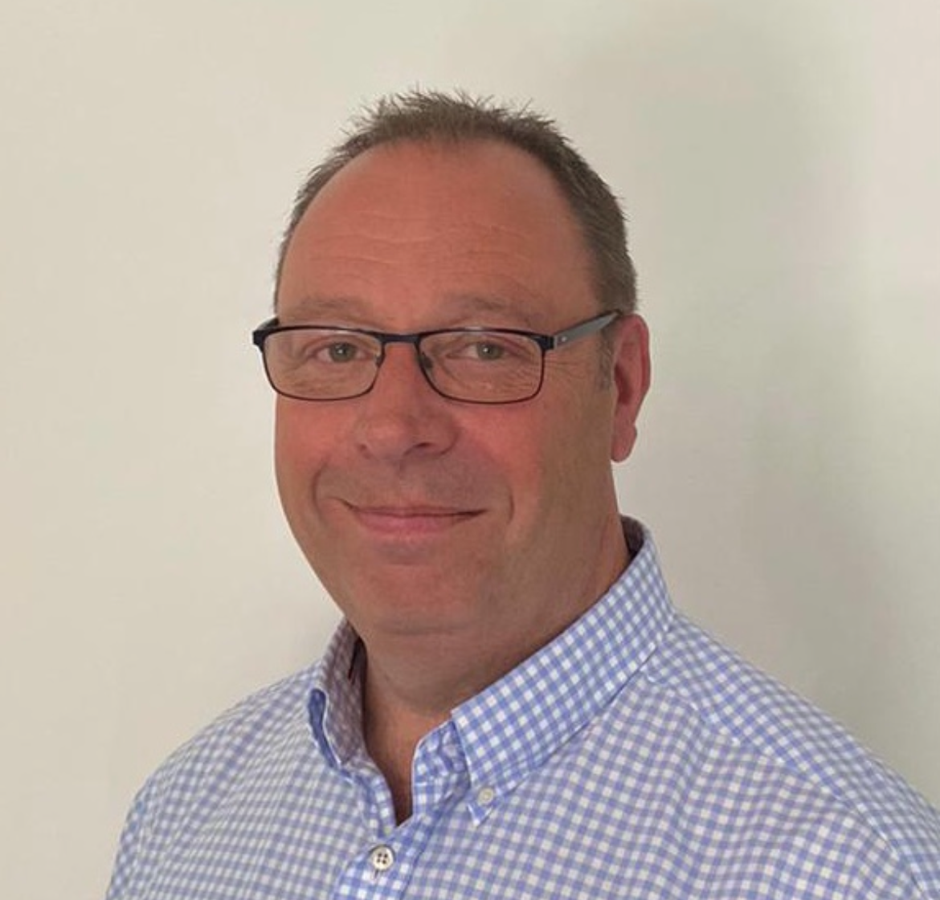
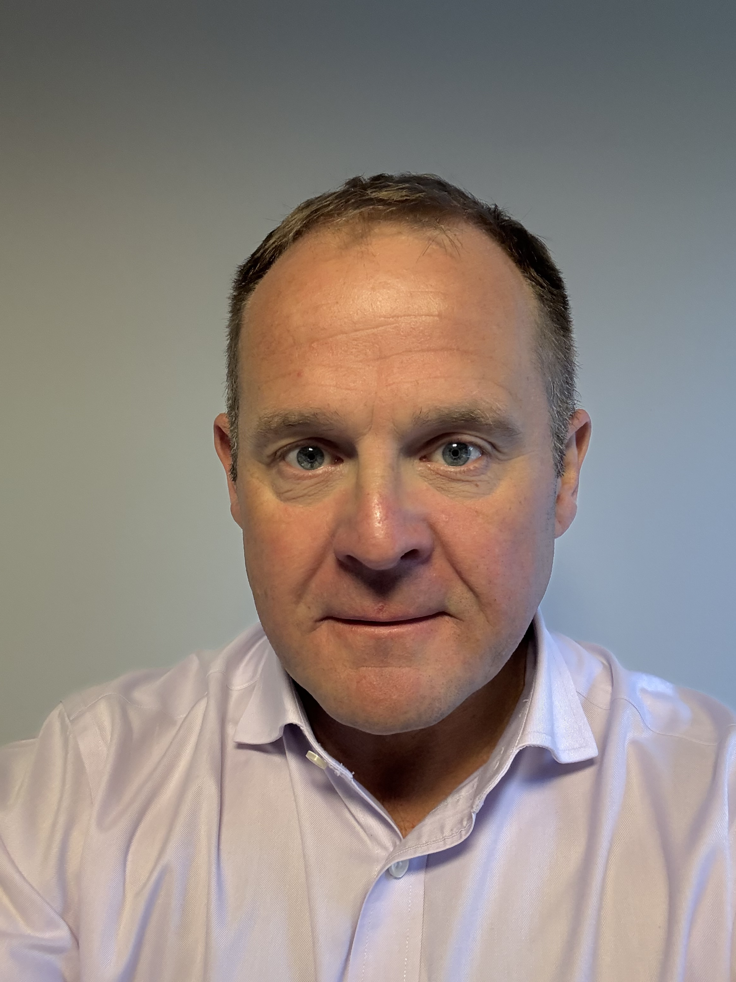
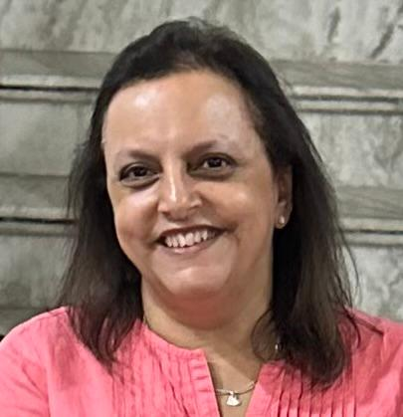
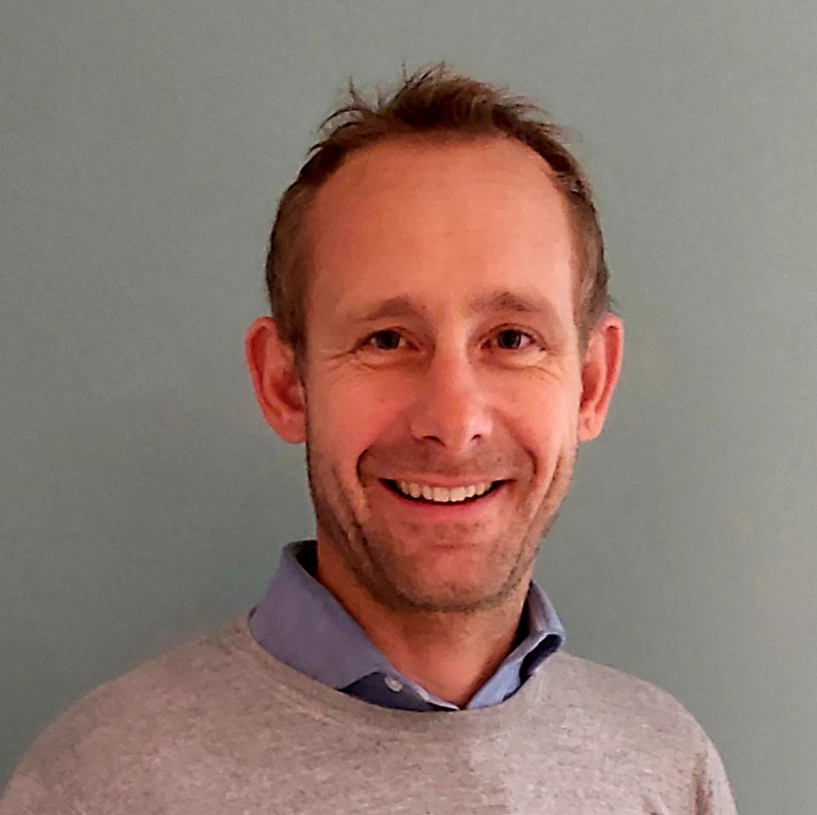
Tandem Group plc
Peter Kimberley
Group Chief
Executive Officer
Dave Poulter
Group Chief Commercial Officer
Gurvinder Kaur
Group Chief
Financial Officer
Charlie Foulkes
Group Digital &
Marketing Director

Slide 3

AGENDA
Product Showcase Video
Retail & Market Landscape
Economic Landscape
Product / Brand Performance & Outlook
Summary

Slide 4
Showcase Video

Slide 5



About Us
Business Divisions
Toys, Sports & Leisure
Outdoor Play &
Licensed Wheeled Toys
Bicycles
Adult, Junior, Kids
Mechanical & eBikes
Golf
Electric & Push Trolleys, Package Sets, Bags, Clubs
Home & Garden Outdoor Living & Home Essentials
UK based designers, developers, importers, distributors and retailers of Sports, Leisure, Bicycles and Home & Garden products
96% of revenue generated LY from UK markets. Our Head office, retail store, and corporate showrooms are based in Birmingham, with an office and showroom facilities in Hong Kong
B2B customers include major national retailers, independent outlets, and direct buyers across Toys, Sports & Leisure, and Bicycles
B2C e-commerce operations spanning all four divisions
Strong licensed portfolio and the UK’s top wheeled toy licensing specialist

Slide 6
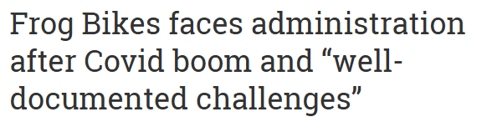
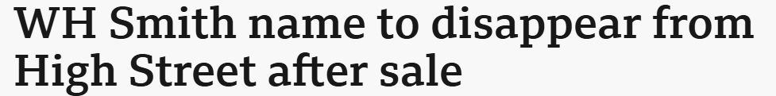
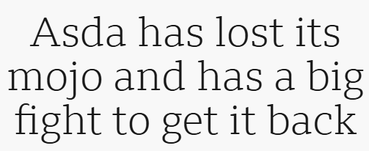
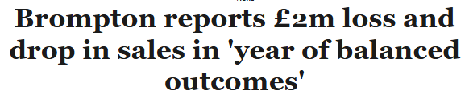

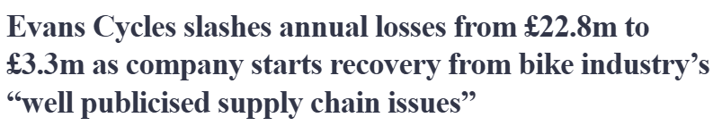
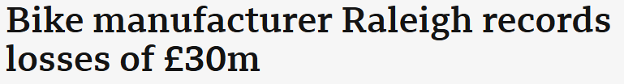
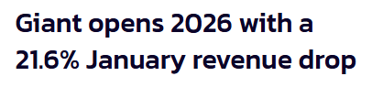

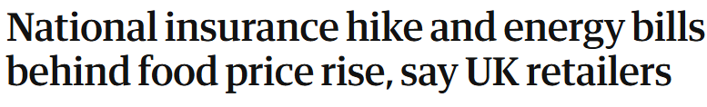


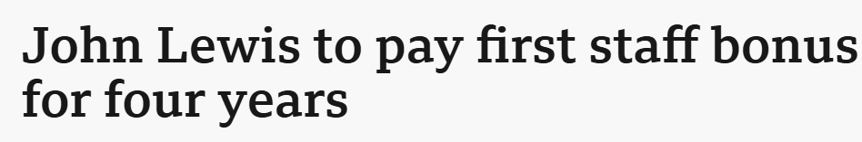
Retail & Market Landscape
UK supply chain can't escape
uncertainty following the Iran war

Slide 7
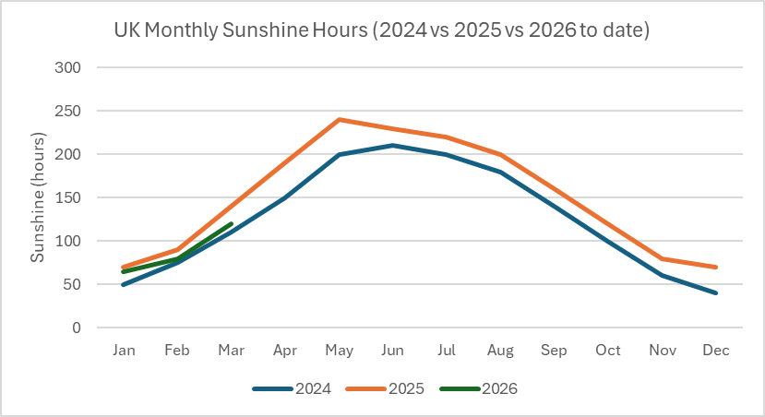
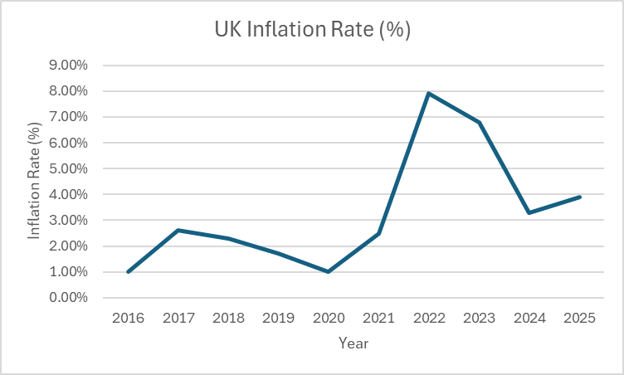
Economic Landscape
Interest rates 3.75% - Banks are nervous
Inflation rate at 3.2% in January, outlook for 2026 was 2.3%
Energy price cap reductions easing operation costs
Unemployment expected to remain stable 4-5%
Shift towards value & essential spending continues
Fuel price increases, due to middle east conflict
  Middle East War impacting increased costs in Sea freight and raw materials.
  Supply chain timelines getting even longer
  Trump Tariff Policies
  Currency volatility (GBP/USD)
  Labour cost pressure from increase in NI & min wage

Slide 8
2025 Financial Performance
Turnover Growth
Gross Margin
EBITDA
Turnover growth
6.2%
(+£1.5m YoY)
Gross Margin %
31.1%
(+£0.8m YoY)
EBITDA
£1.2m
(+£0.5m YoY)
Stock Level Control
Borrowings
Strong Balance Sheet
Inventories
£4.4m
(-£1.5m YoY)
IBD
£1.9m
(-£2.4m YoY)
Net assets
£26.1m
(+£2.2m YoY)

Slide 9
2026 Financial Outlook
 | FY24 | FY25 | FY26E*
Revenue | £24.6m | £26.2m | £27.8m
Gross profit | £7.4m | £8.1m | £8.5m
Costs | £7.0m | £7.2m | £7.4m
Finance costs | £0.4m | £0.3m | £0.4m
Profit before tax | £0.0m | £0.6m | £0.7m
Results and outlook
*Cavendish Capital Markets, current market expectations of performance for FY26.

Slide 10
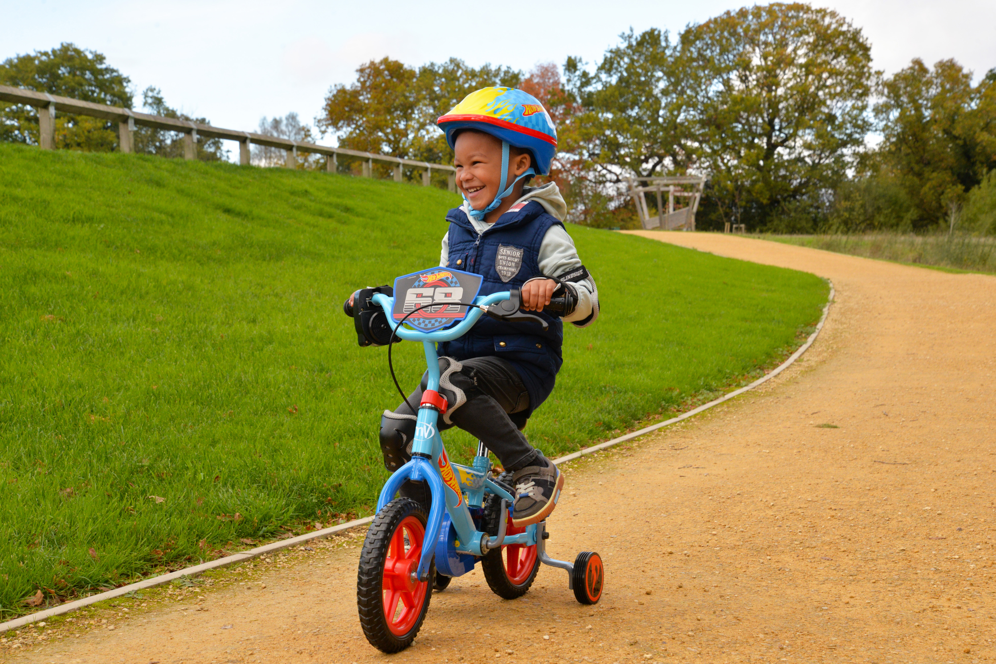
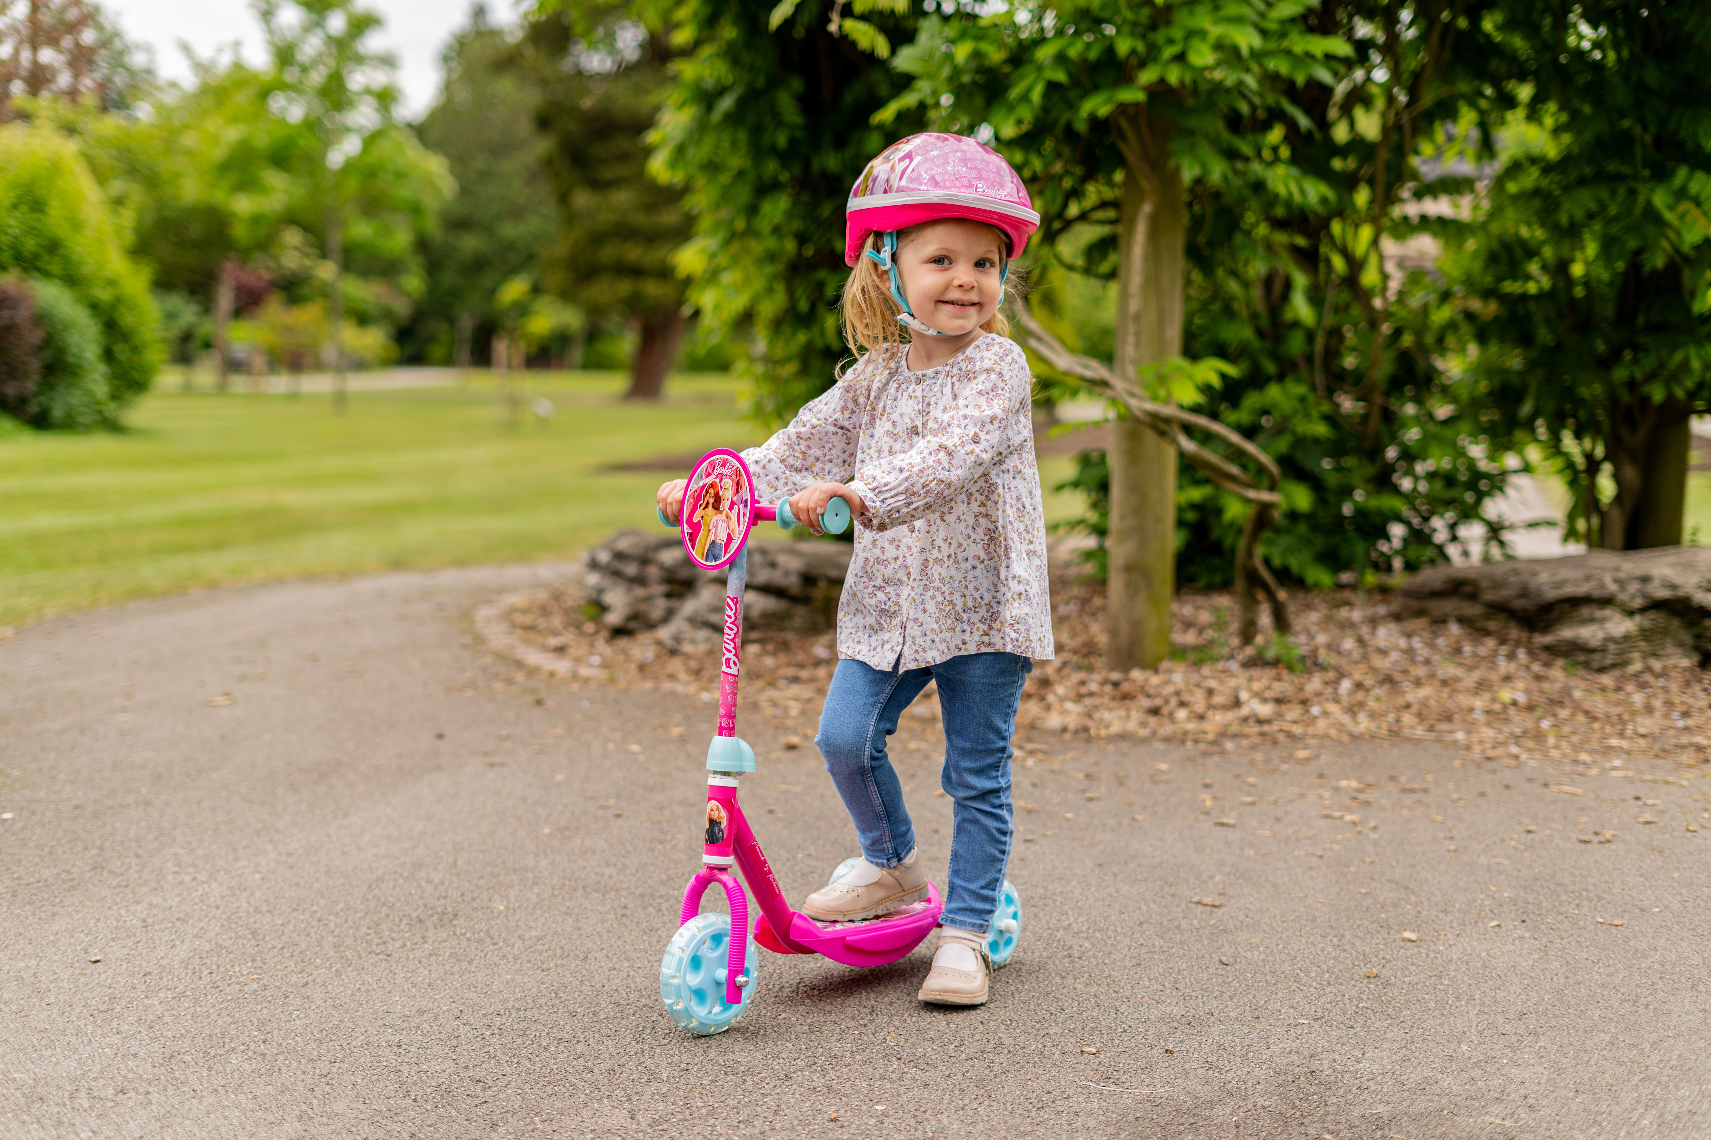
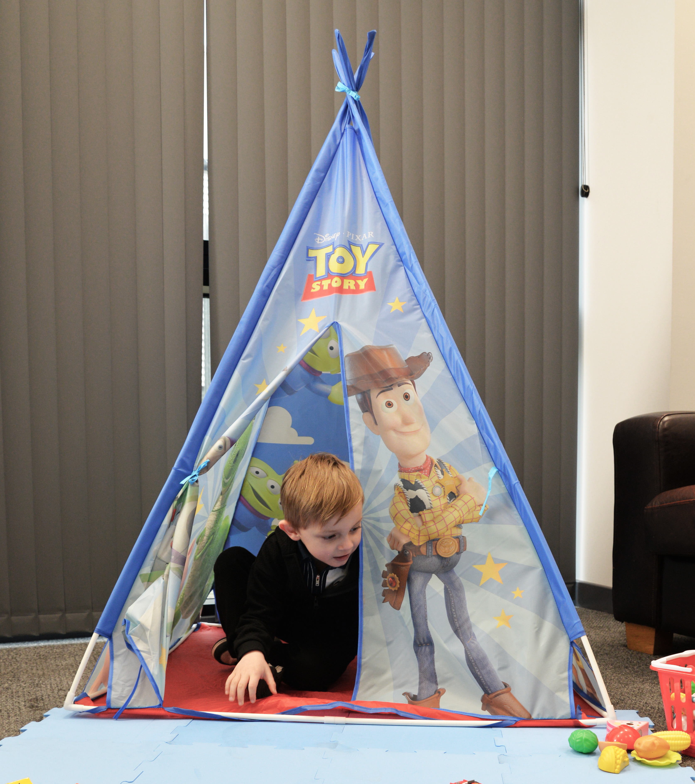
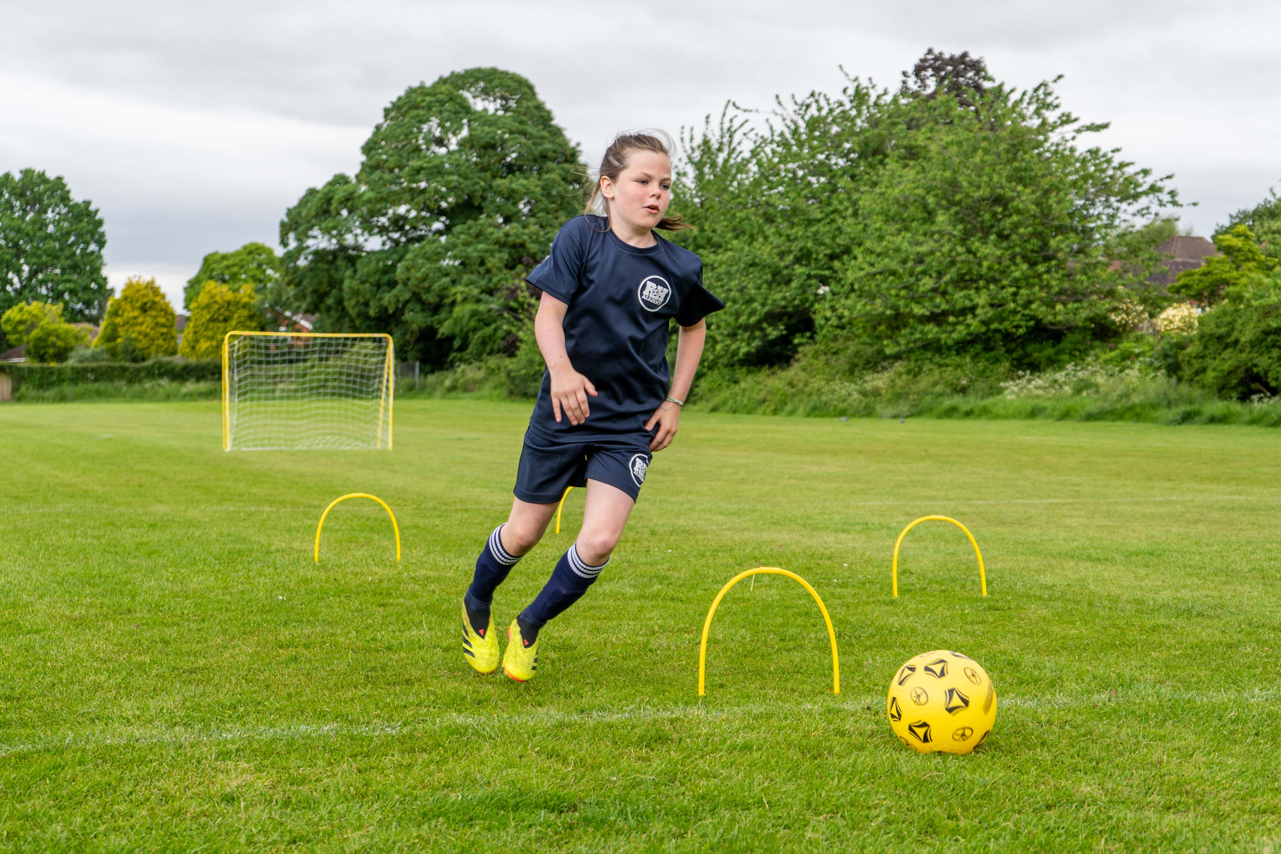
Toys, Sports & Leisure
2025 Performance
Revenue declined 17.5% year-on-year, reflecting softer demand across discretionary categories and evolving retailer purchasing patterns.
Licensed wheeled products remained resilient, with strong consumer engagement supporting continued brand momentum.
Own-brand sports and leisure ranges gained traction, supported by improvements in product mix, positioning and retail engagement.
Online channel delivered strong growth, with marketplace sales increasing 34% year-on-year.
Continued investment in product innovation and category development, supporting competitiveness and customer relevance.
Industry recognition across both licensed and own-brand products, including awards from Right Start, Outdoor Toy Awards and Made For Mums.
2026 Outlook
Exclusive UK & Ireland partnership secured with Netflix for 2x Academy Award-winning K-Pop Demon Hunters - a unique, high-impact platform for future growth in licensed wheeled products.
Strategic expansion into car accessories, a high-margin, non-seasonal category, leveraging existing retailer relationships, expanding shelf space, and driving repeat purchase revenue beyond core wheeled products.
Strong start to FY26, trading in line with, and building momentum ahead of, Board expectations.
Early acceleration across FOB and European sales, both outperforming prior year.
Premium licensed portfolio expanding, with global power brands including Toy Story, Dora and Marvel Avengers.
Core licenses delivering consistently, with Stitch, Bluey and Hot Wheels driving sustained, high-quality growth.

Slide 11
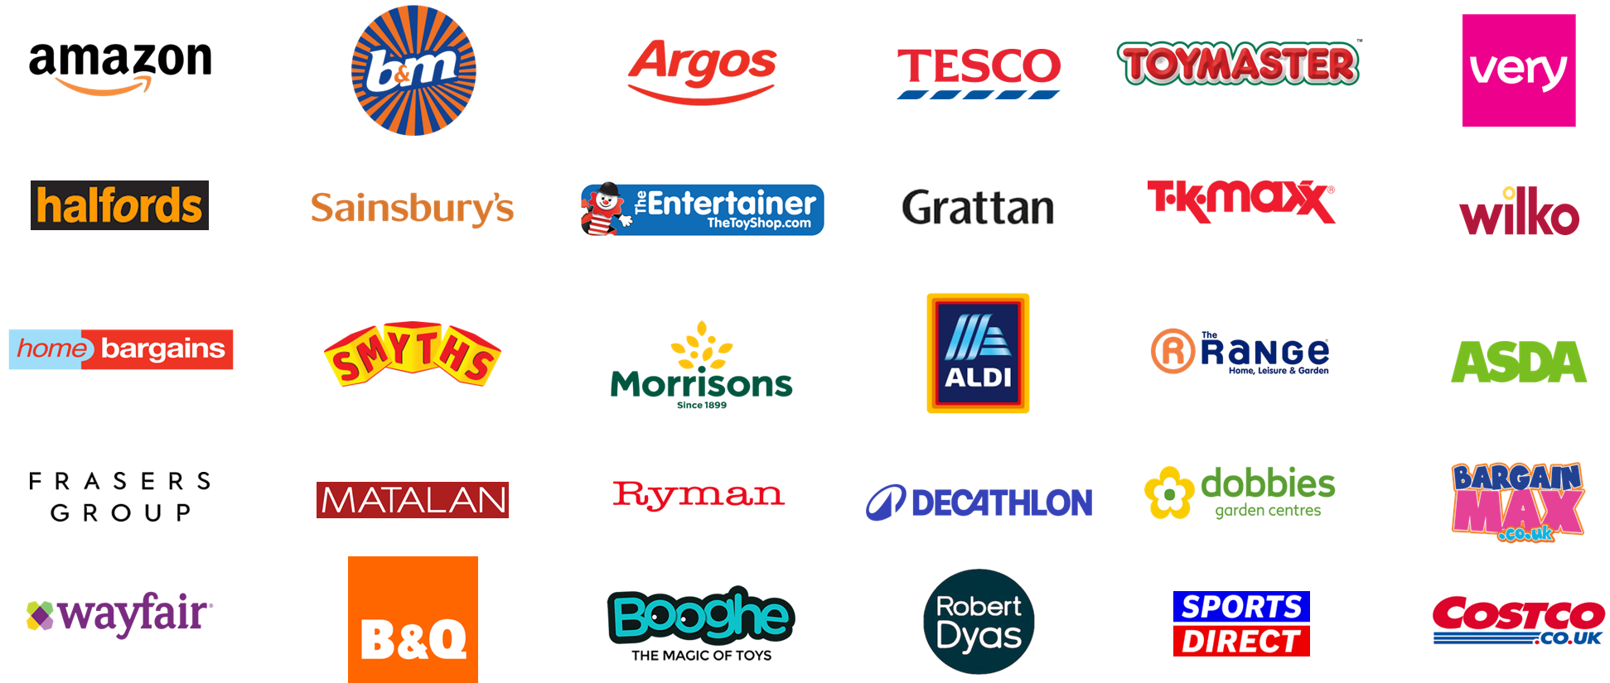
Toys, Sports & Leisure Retail Distribution

Slide 12
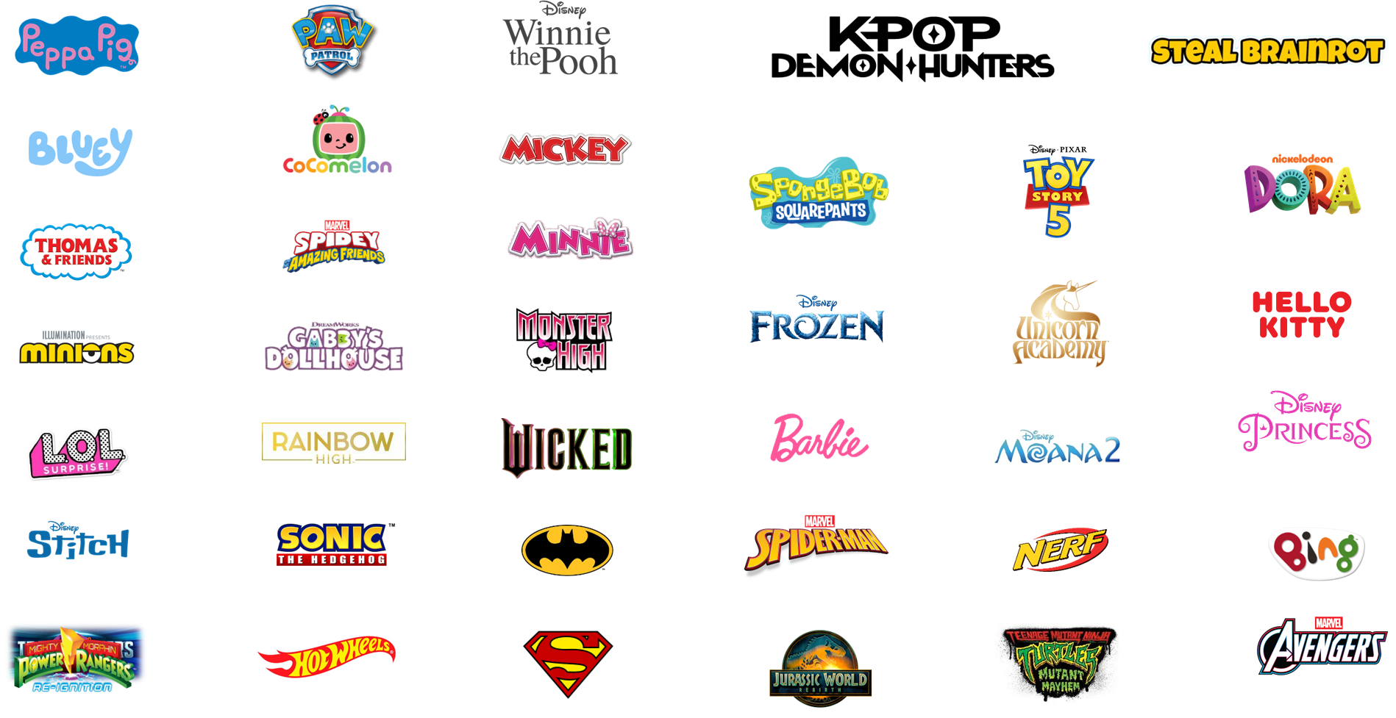
Toys, Sports & Leisure Licensed Brands

Slide 13
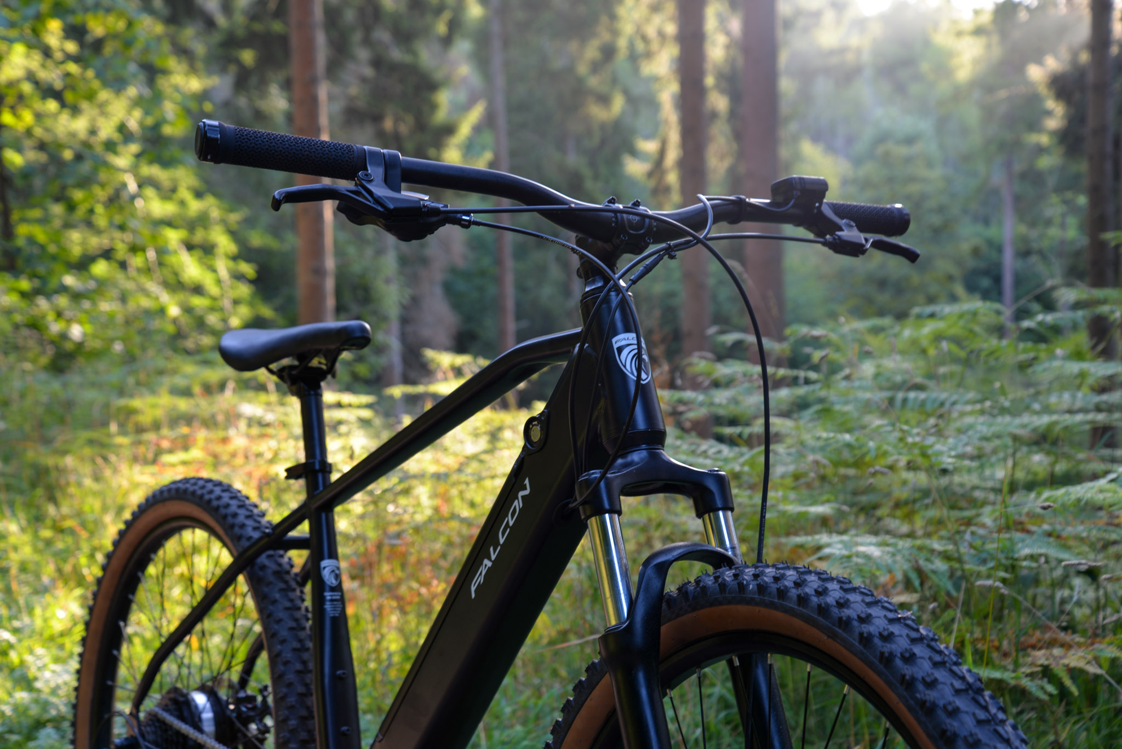
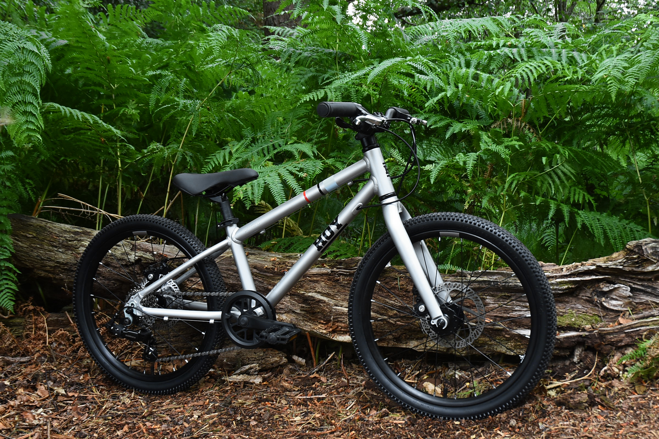
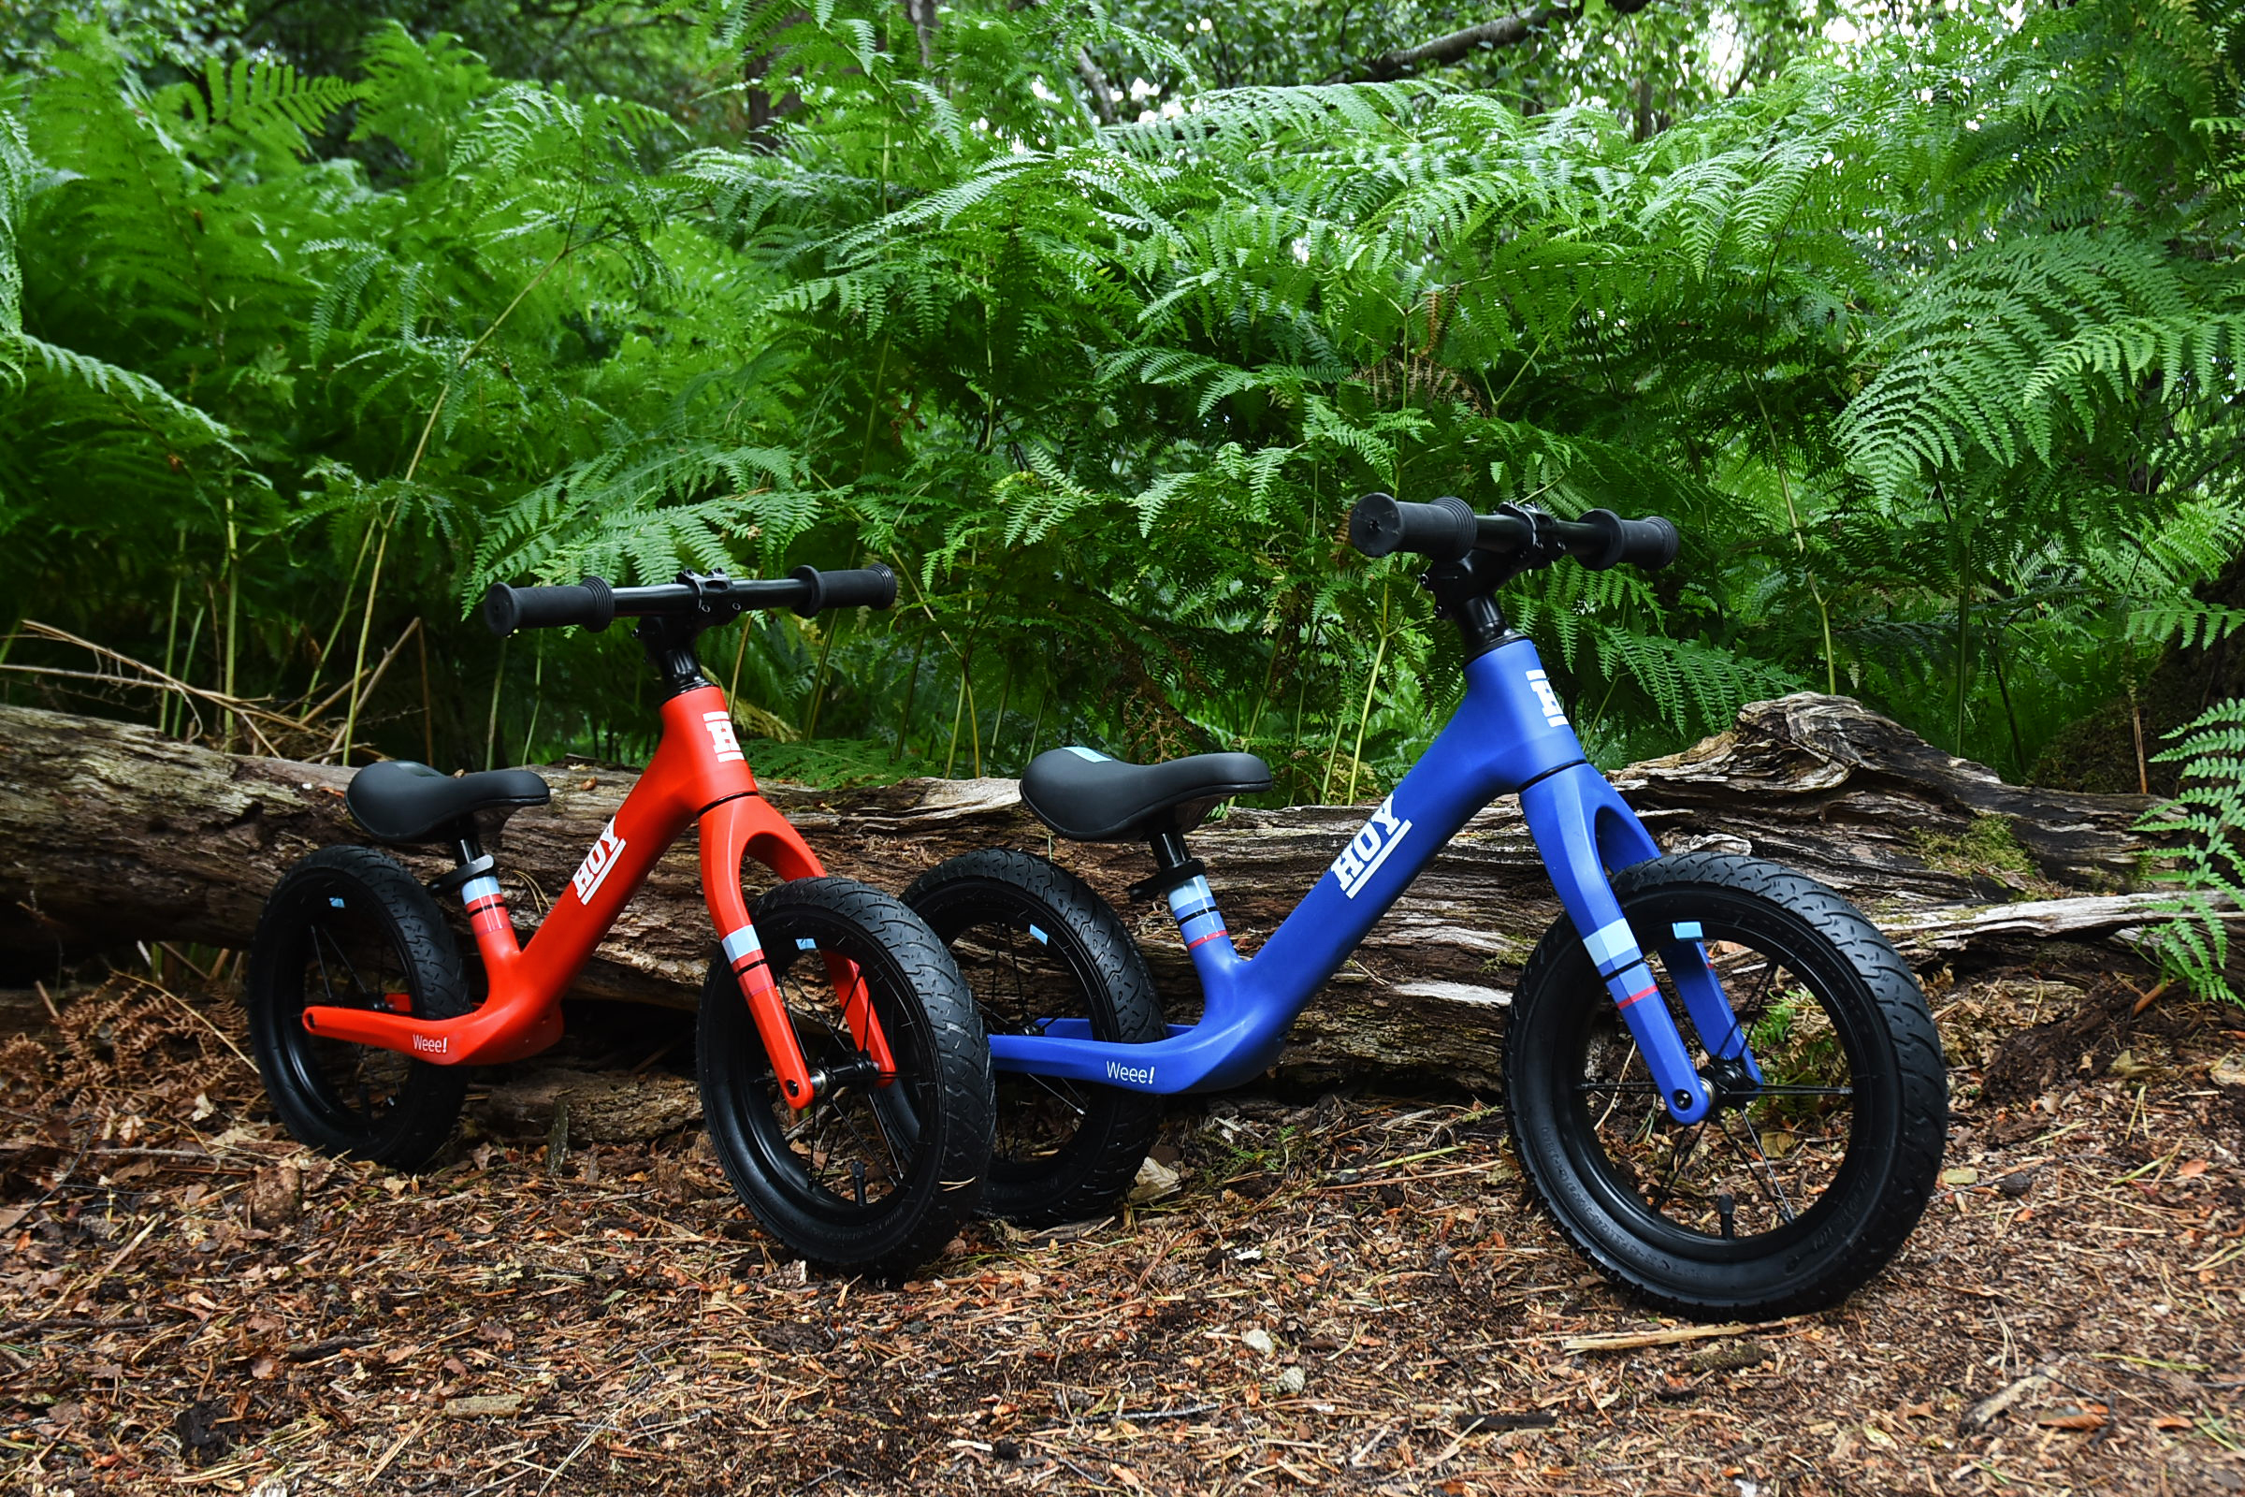
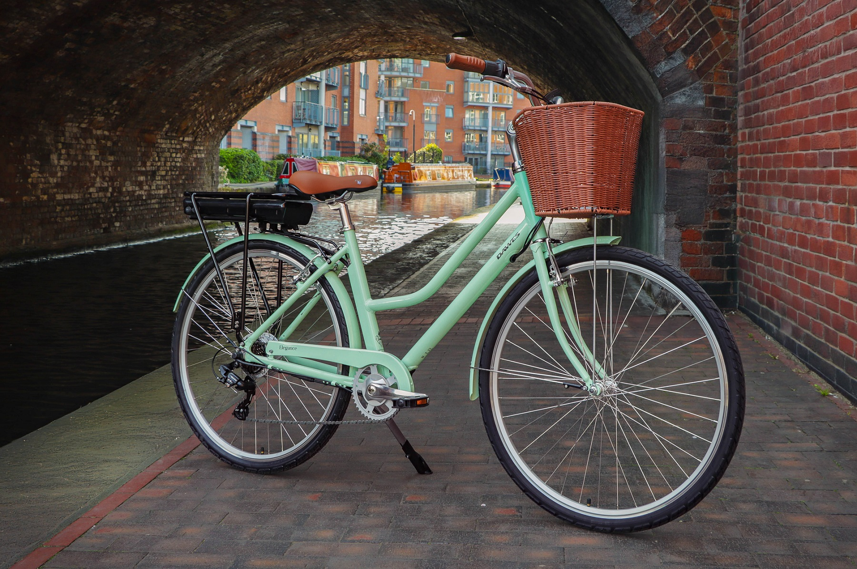
Bikes
2025 Performance
Sales grew +38% vs last year
A challenging market across all channels
Own-brand electric bike sales grew +70% and now account for over 65% of the category
Significant +47.6% uplift in mechanical bike sales and +10.7% in children’s bikes sales
Launched an exclusive range of premium lightweight kids bikes in partnership with Sir Chris Hoy
Established a UK-wide retail and servicing network for VanMoof, the leading smart eBike brand
Added the leading global bike brands, Trek, Amflow and Brompton, to our Electric Life retail proposition
2026 Outlook
The leading distributor in affordable eBikes and mechanical bikes to national retailers and independent bike dealers
A comprehensive range of eBikes covering all styles/disciplines from £999.99
Maximise continual opportunities in the growing lightweight kids’ bikes segment with Squish and HOY bikes
Launch of 6 x new entry price electric bikes in the key sub-£1100 electric bike category
Launch a new range entry price point adult/junior mechanical bikes and a refreshed range of BMX bikes
Introduce our bike portoflio internationally via different distribution channels across Europe

Slide 14
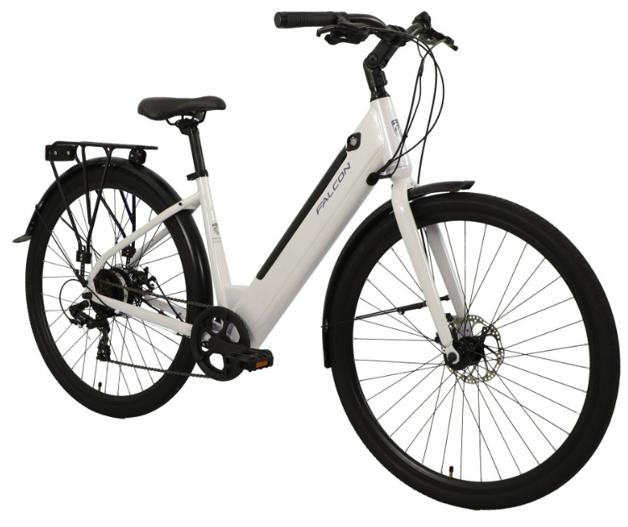
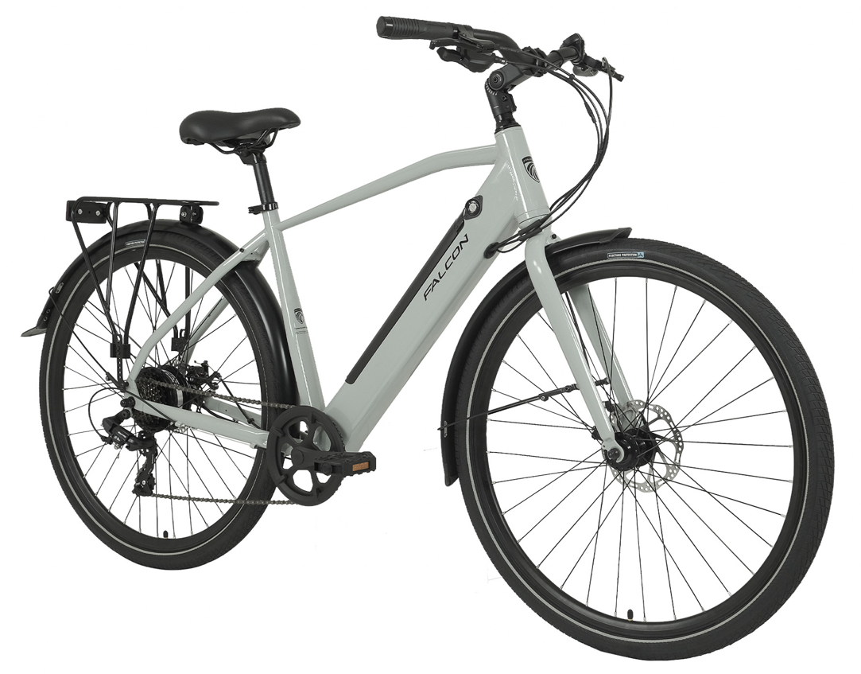
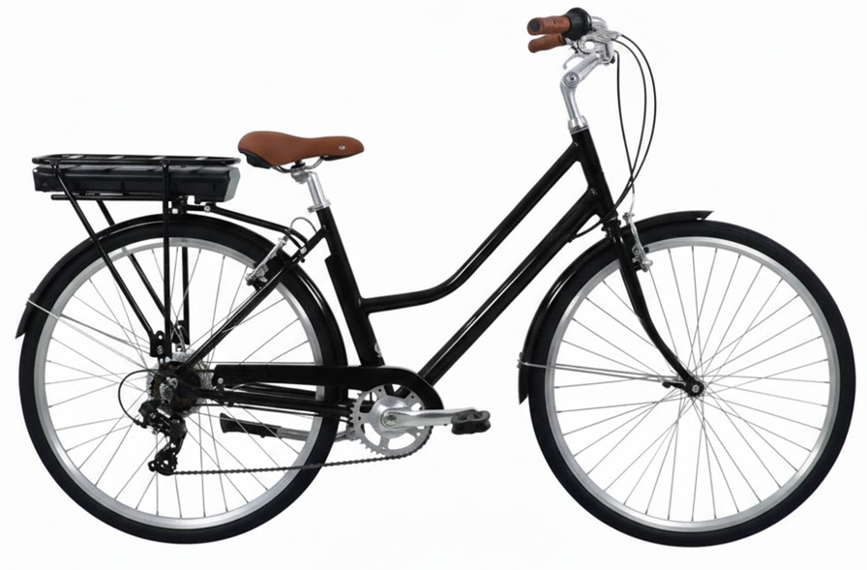
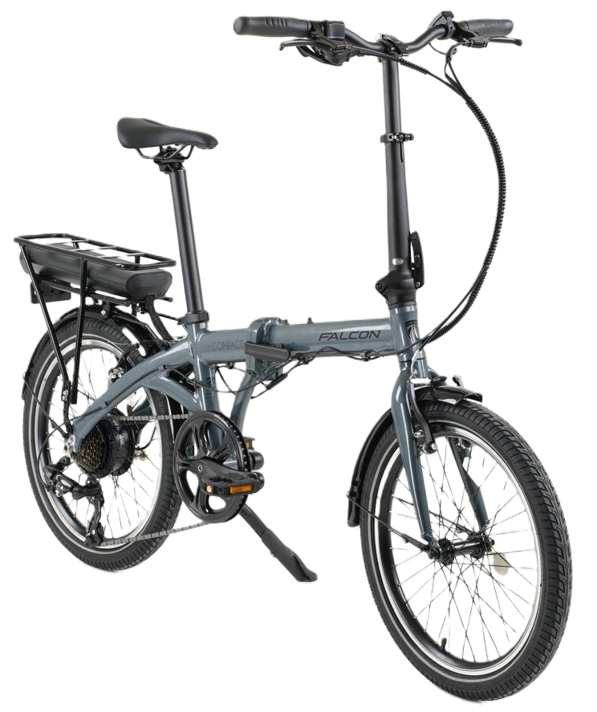
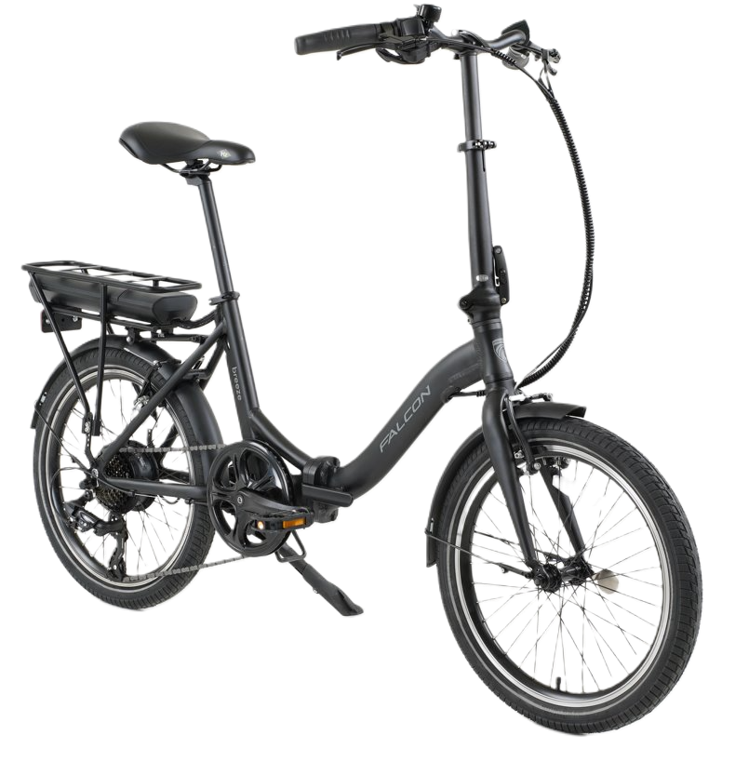
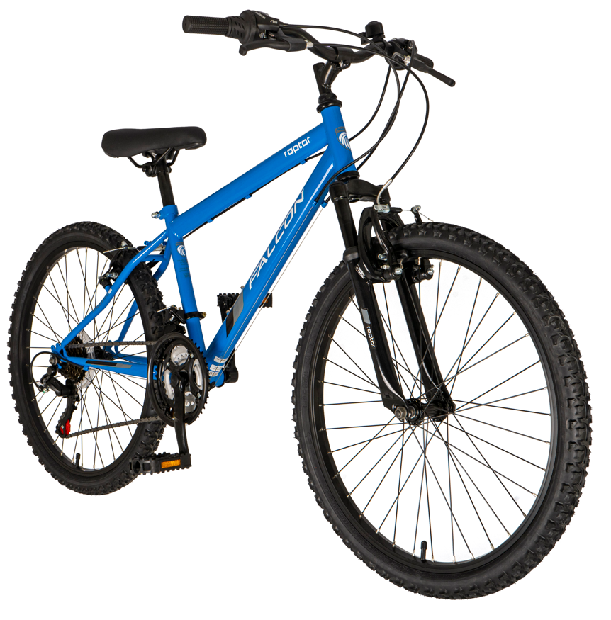
Bikes New Products
Falcon Liberty Low Step eBike
Falcon Liberty Crossbar eBike
Falcon Heritage eBike
Falcon Compact eBike
Falcon Breeze eBike
Falcon Junior 26" Range

Slide 15
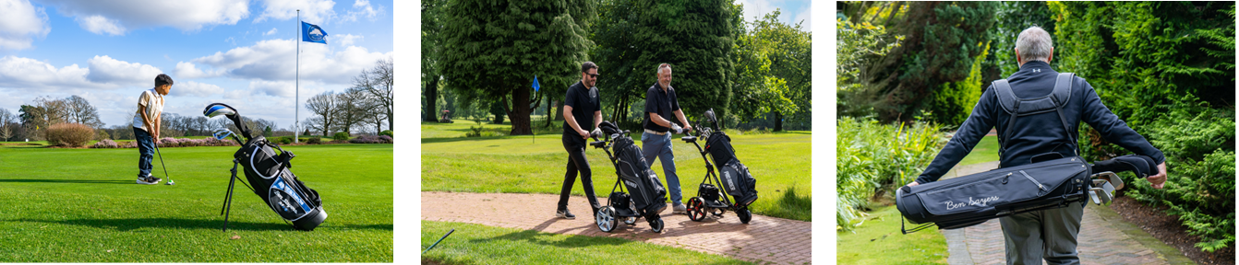
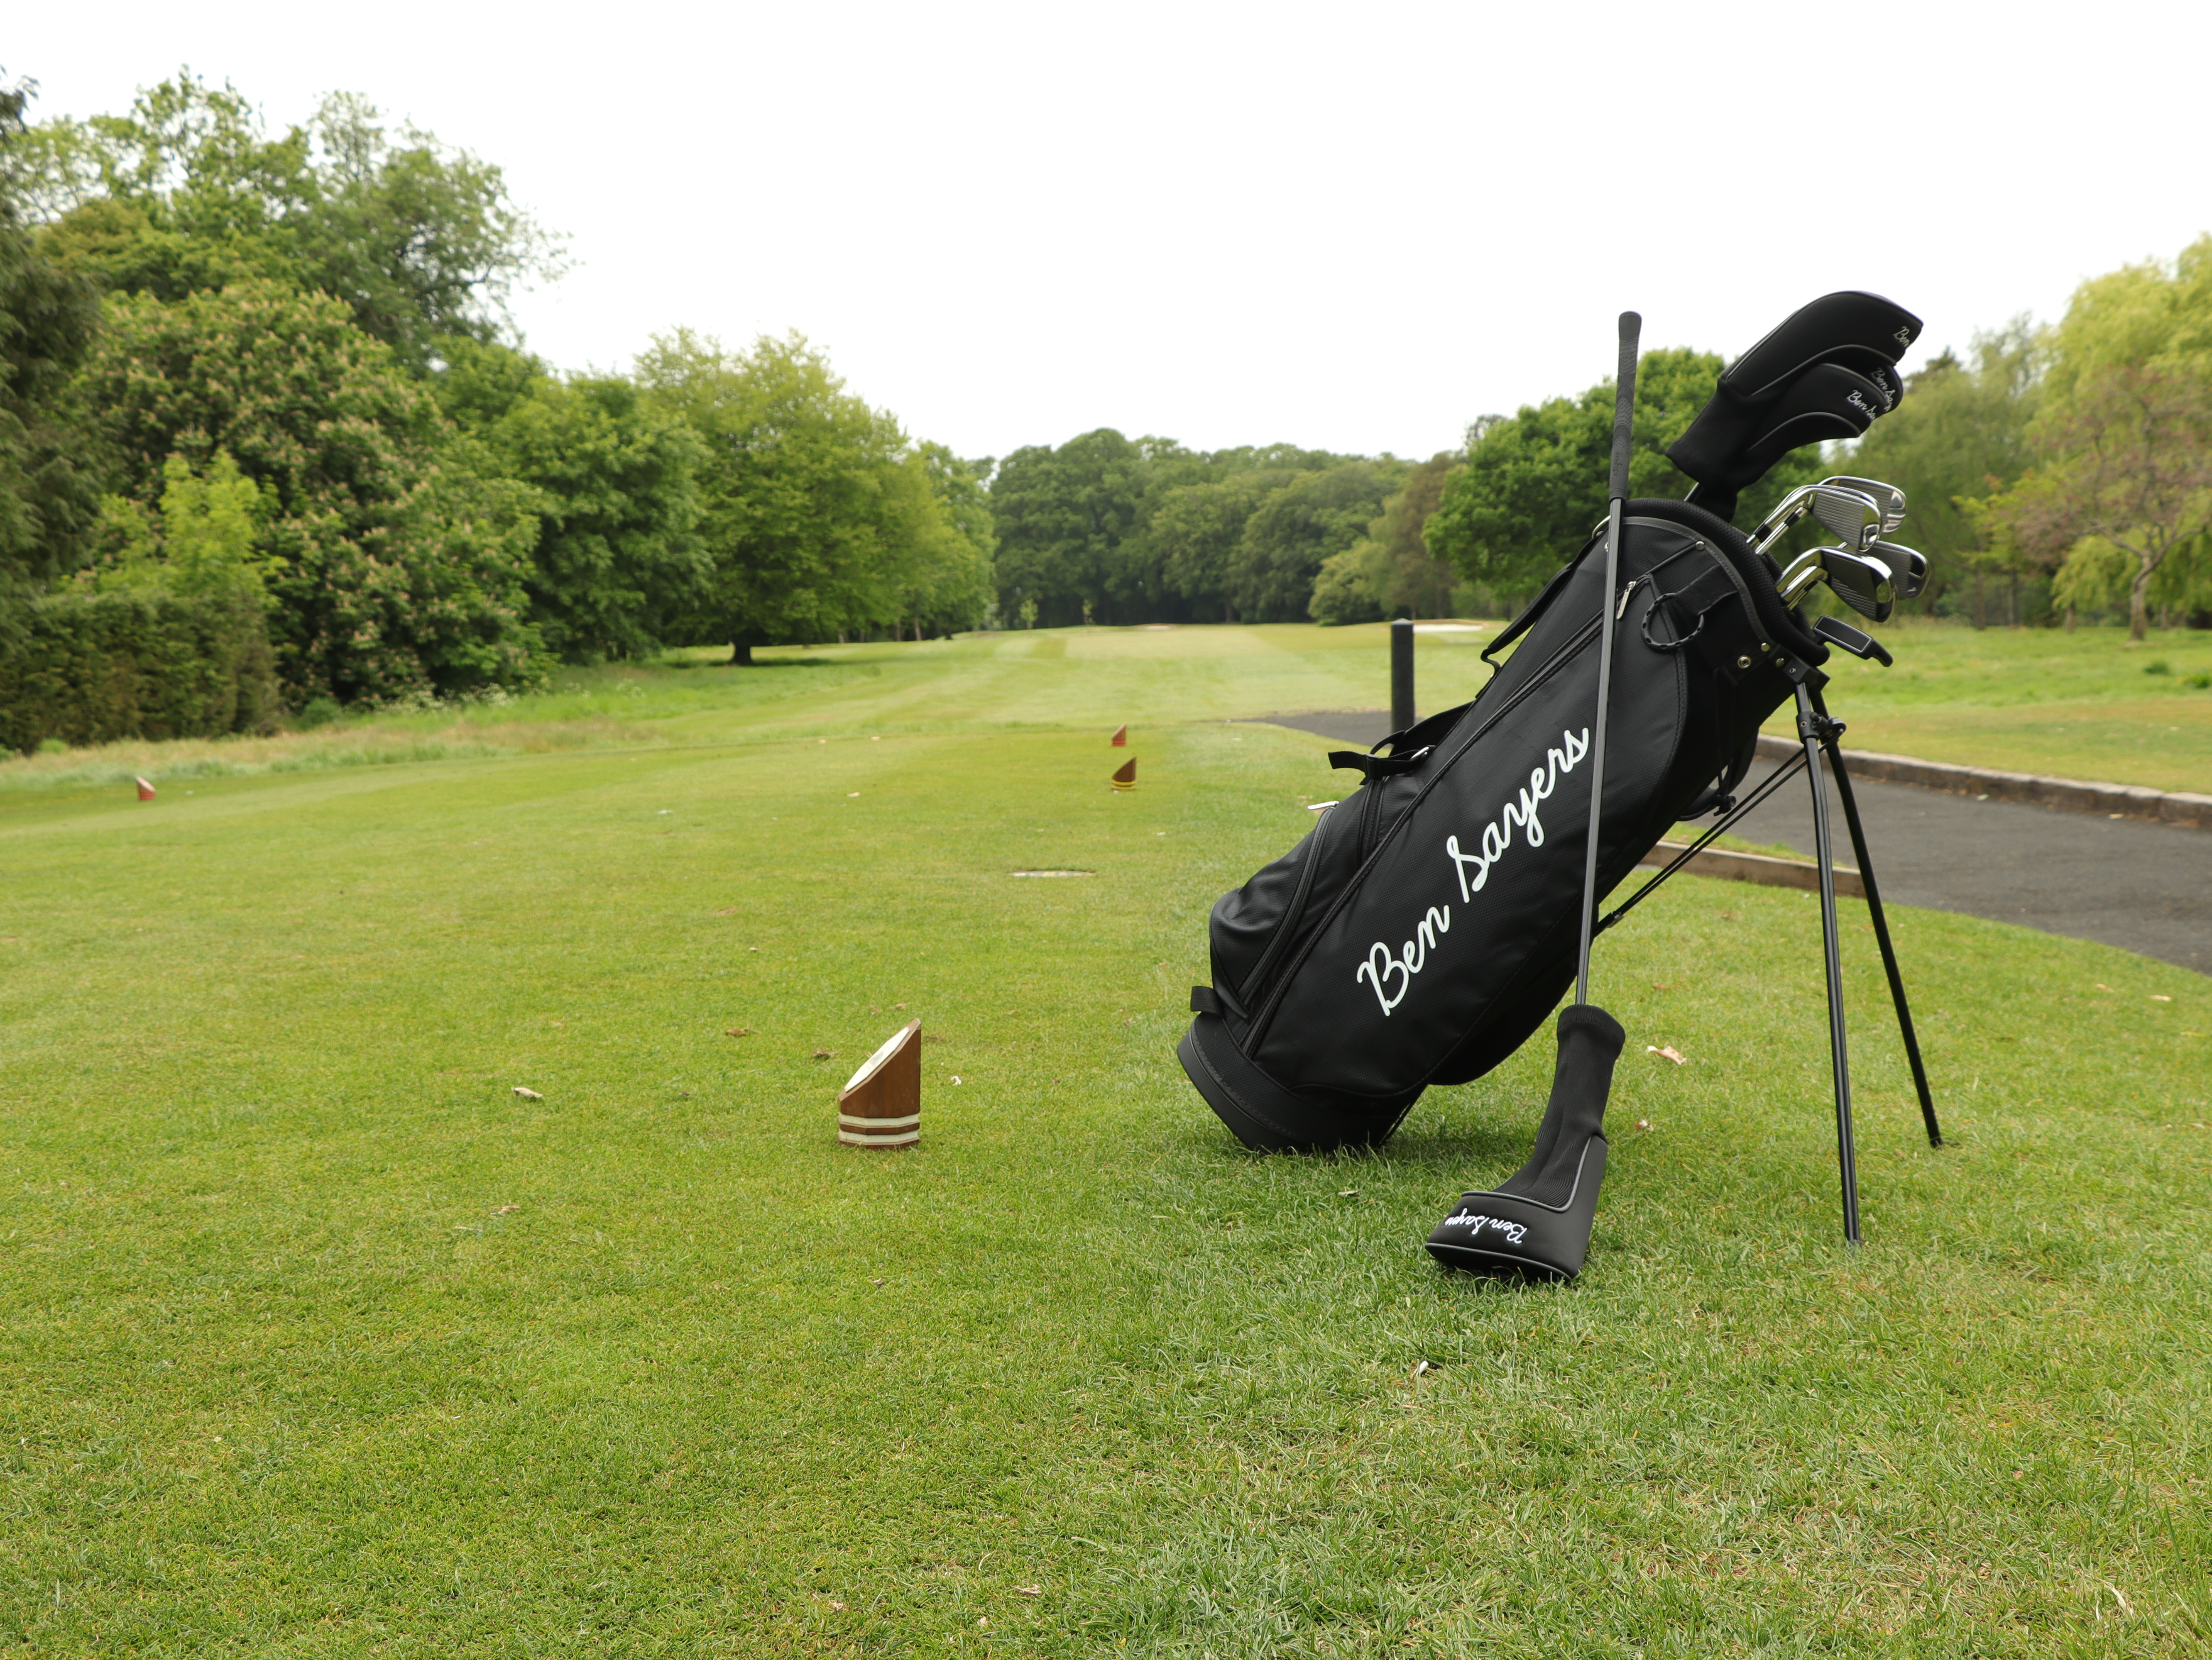
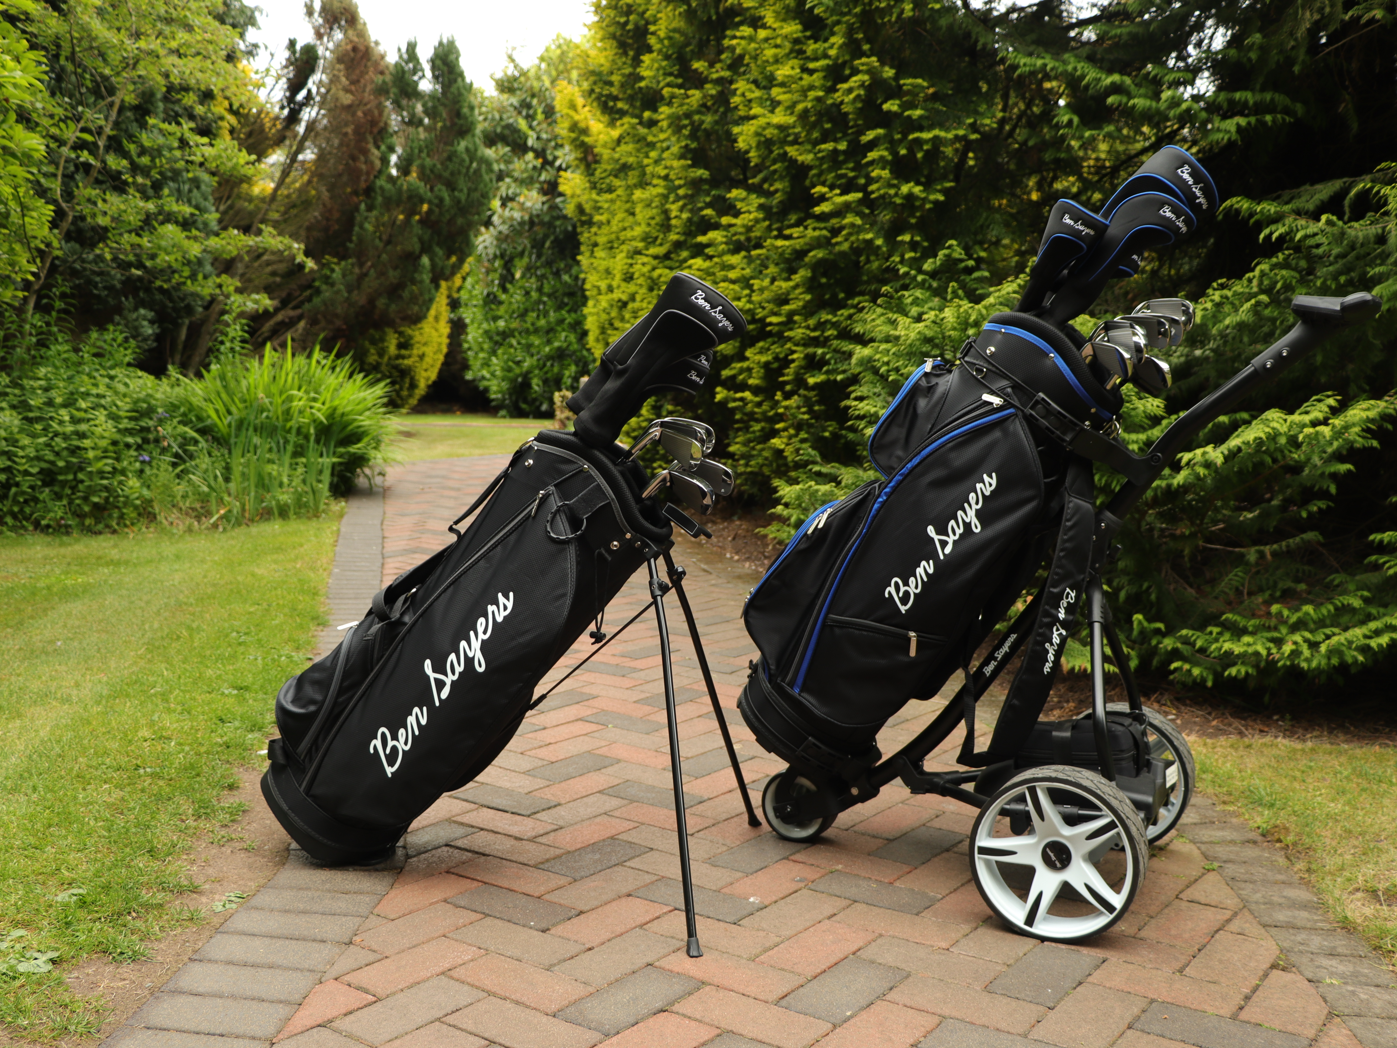
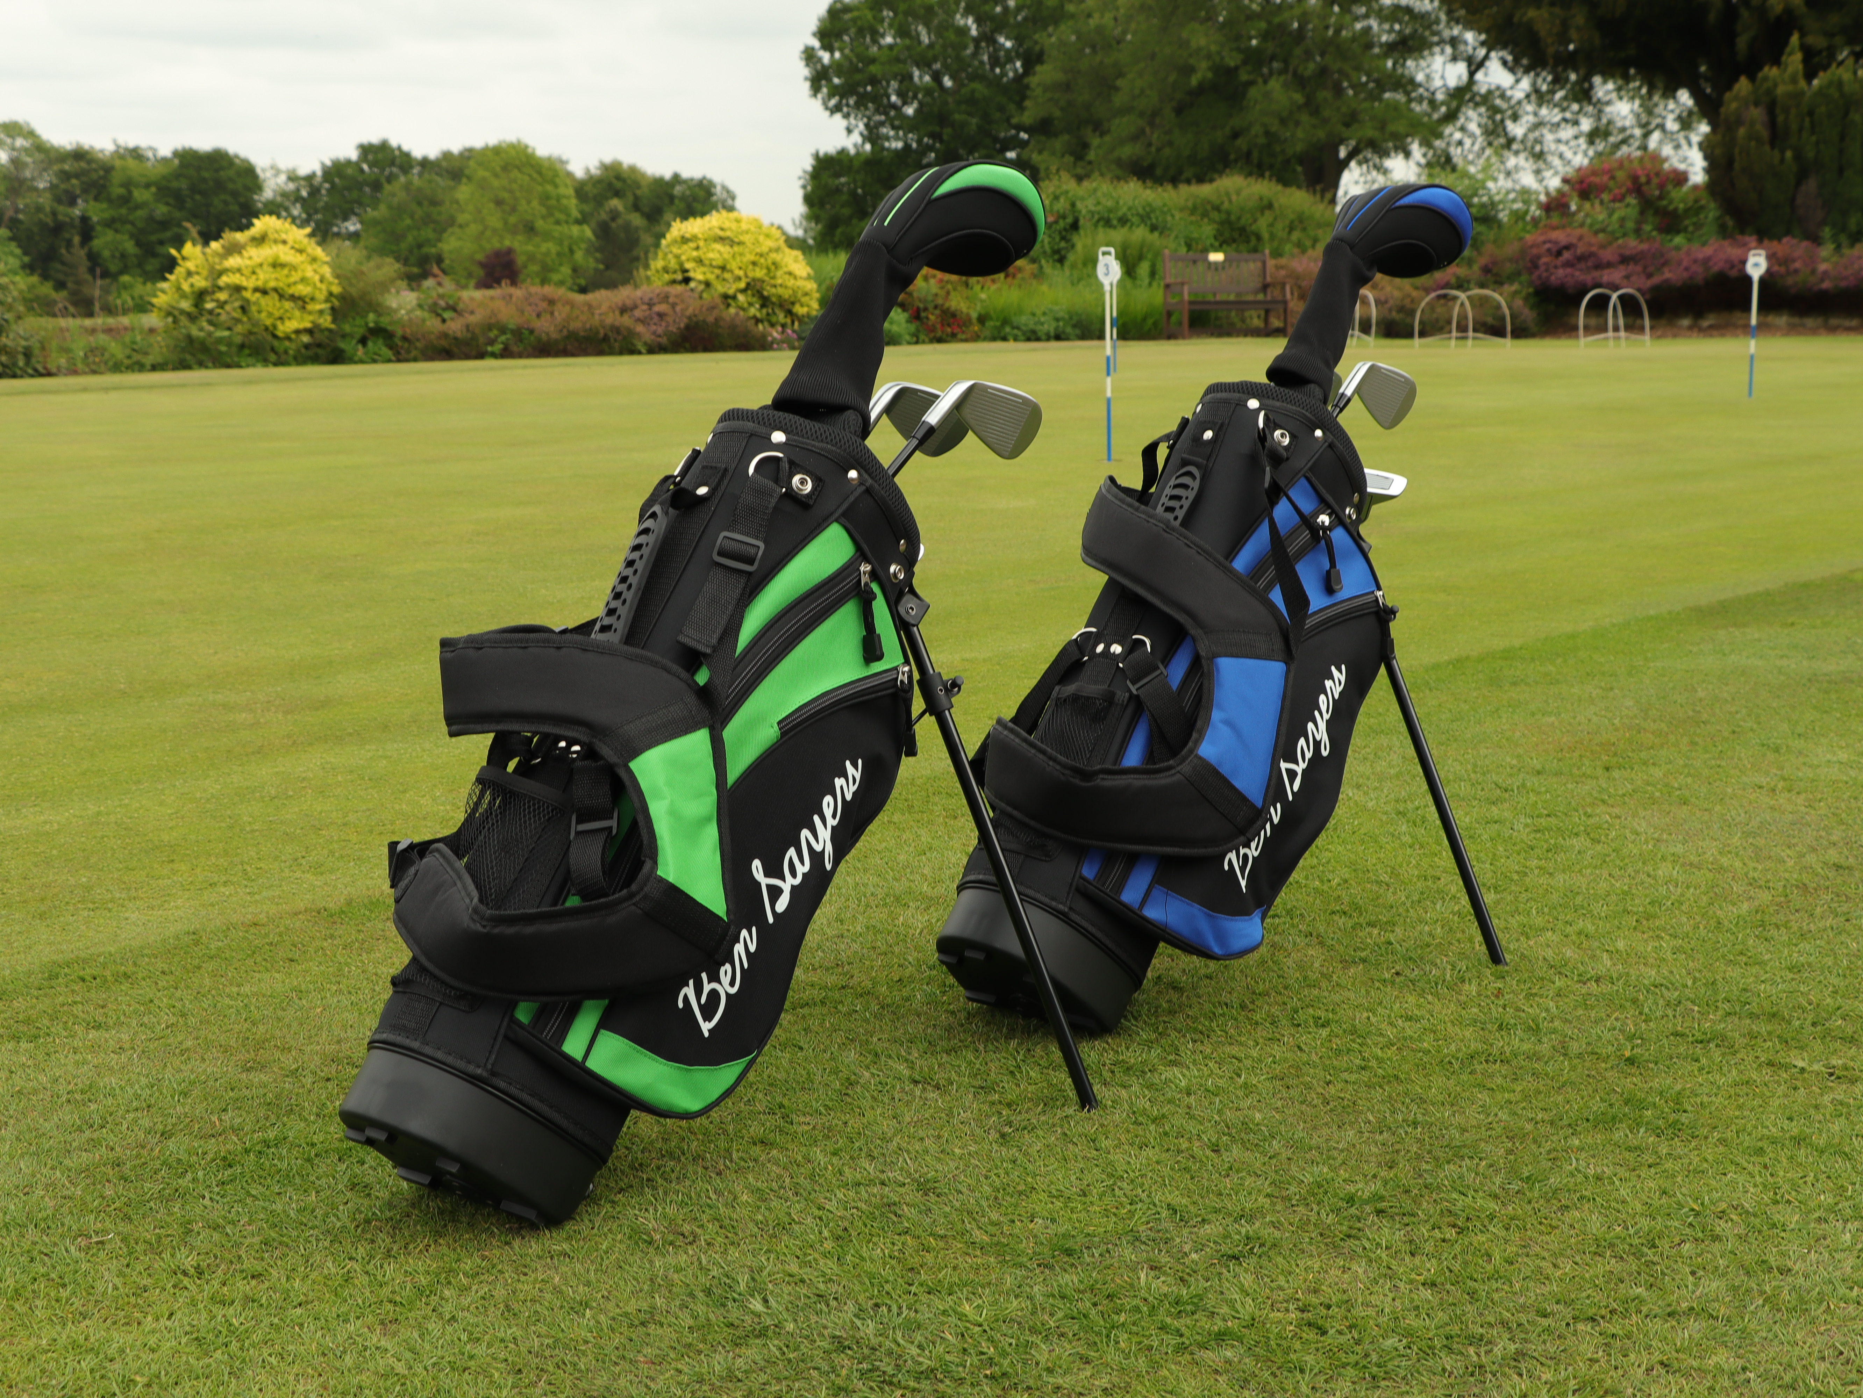
Golf
2025 Performance
Sales grew 9% vs last year
Golf Datatech reported +6% full year market growth
Ben Sayers gained market share with new package sets
Pro Rider sales grew +26%, driven by full year availability of our colour-refreshed electric trolleys range.
Introduced 19 new adult and junior package sets including all-new club designs, and 13 new bags.
Increased the value of direct container orders
Designed exclusive Ben Sayers colour ways to UK national golf retailers
Introduced Pro Rider electric trolleys and junior package sets into new national retailers
2026 Outlook: Ben Sayers
Ongoing development of the next generation of electric trolleys
Transition more key accounts to direct container purchasing with a focus on exclusive product options/colour ways
Expand domestic range representation with new on-course and off-course retailers
Accelerate international growth with European golf distributors & retailers
2026 Outlook: Pro Rider
Cement ourselves as the best value-for-money electric golf trolley brand in the market
Stable year-round product availability to capture sales across own-brand websites and marketplaces

Slide 16
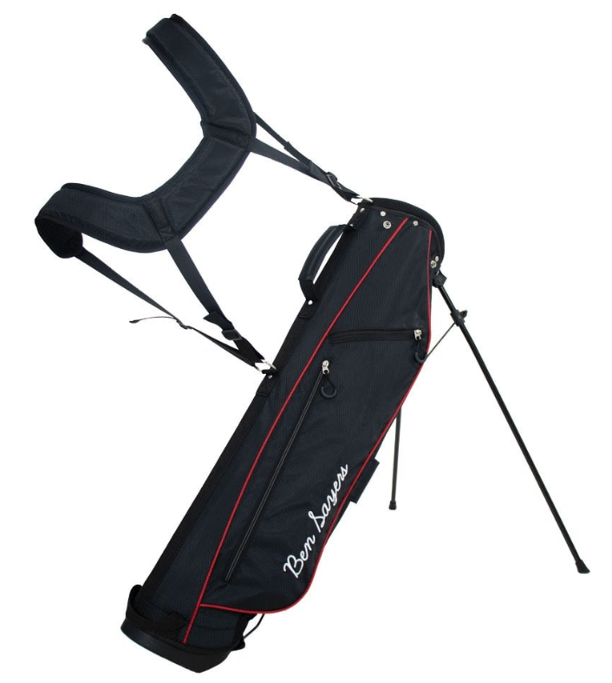
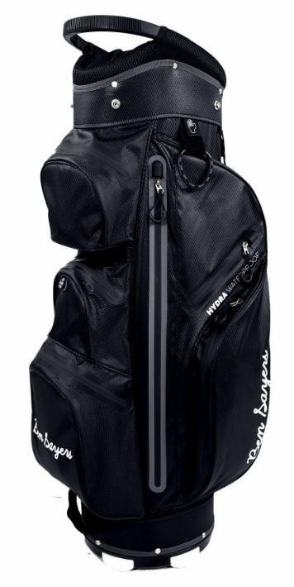
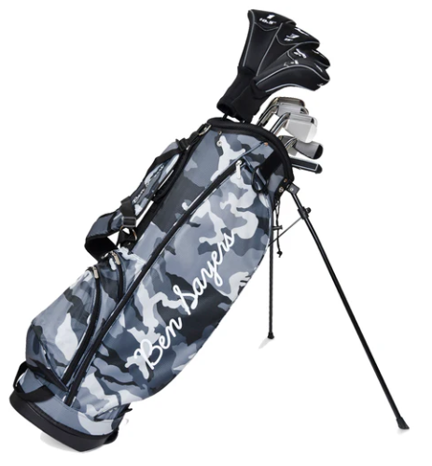
Golf New Products
Ben Sayers M8 Package Sets – Camo Exclusive
Ben Sayers Hydra Pro Cart Bags
Ben Sayers LTE Pencil Stand Bags

Slide 17
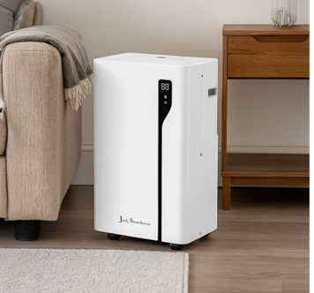

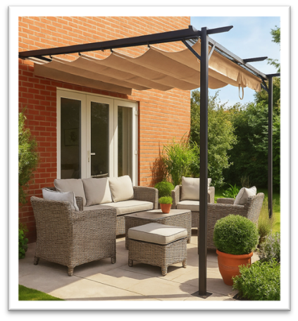
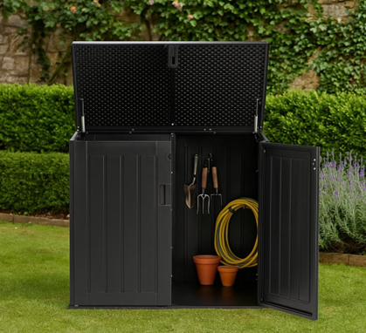
Home & Garden
2025 Performance
Sales +30% vs last year - multiple heatwaves , boosting demand for cooling & outdoor products
Over 260 Home & Garden SKU’s across website & marketplaces
Grown core performing categories: Cooling, Radiator covers, outdoor storage, awnings/parasols
Launched +72 new SKUs, across new categories: outdoor heating, outdoor rugs, planters internal storage, outdoor living.
New third-party EU & UK suppliers, trial products/speed to market
Grew new marketplace channels, expanding customer reach (Temu)
Website transactions increased +29%, while average order value increased +13%
+44% improved PPC Return on Advertising Spend(ROAS)
2026 Outlook
Performance tracking to sales forecast expectation
Growing product range listings by year-end, +15% L4L
  Q1 launched new cooling, heating, outdoor living, parasol & awning range
  Q2/Q3 launching new metal storage / children's furniture
Improved L4L stock availability to meet trading forecast
Strengthen EU and UK supplier relationships to trial new products
New direct dispatch partnership with UK supplier, mitigating stock holding costs
Flexible ordering /mixed containers, reducing stock holding costs
Increasing average order value and basket count with wider range selection
Continue marketplace growth to reach new customers (OnBuy)
Improving marketing ROI, leveraging AI, content & product listings

Slide 18
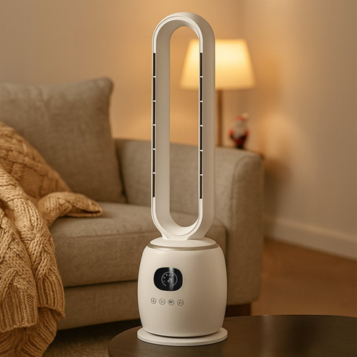
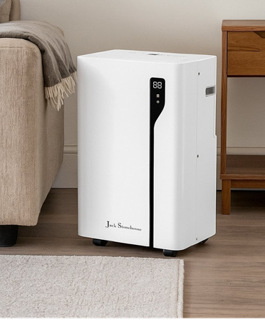

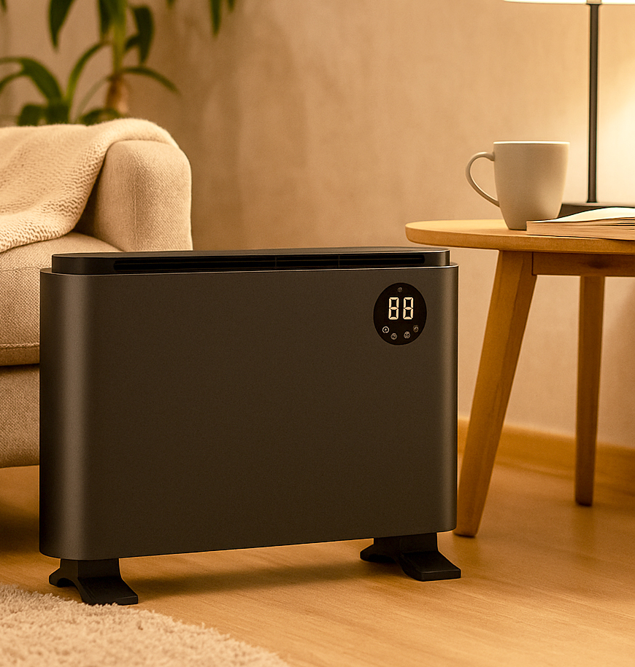



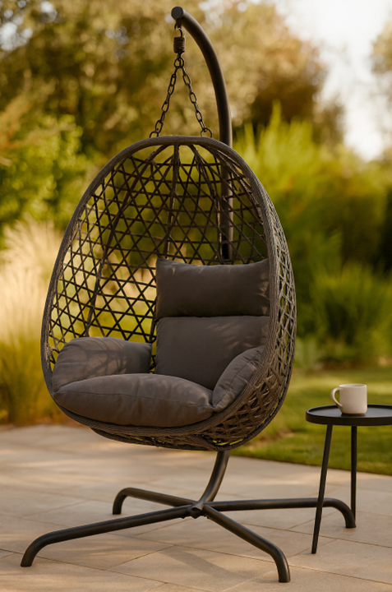

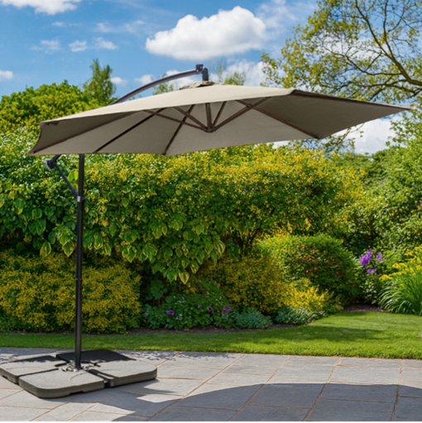
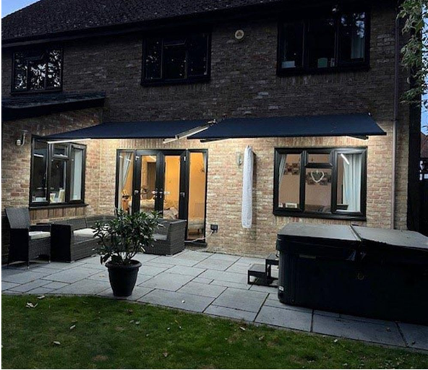
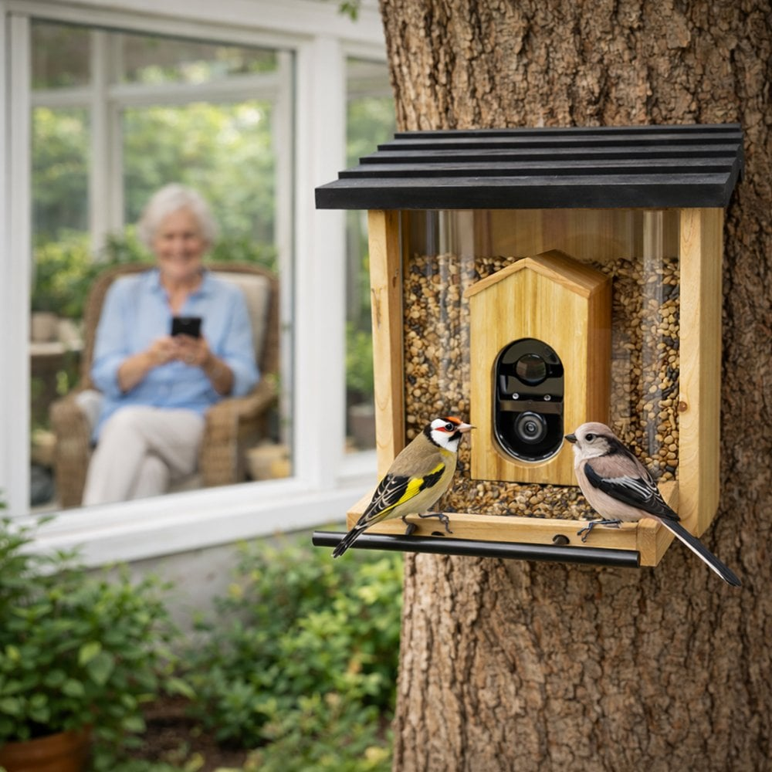
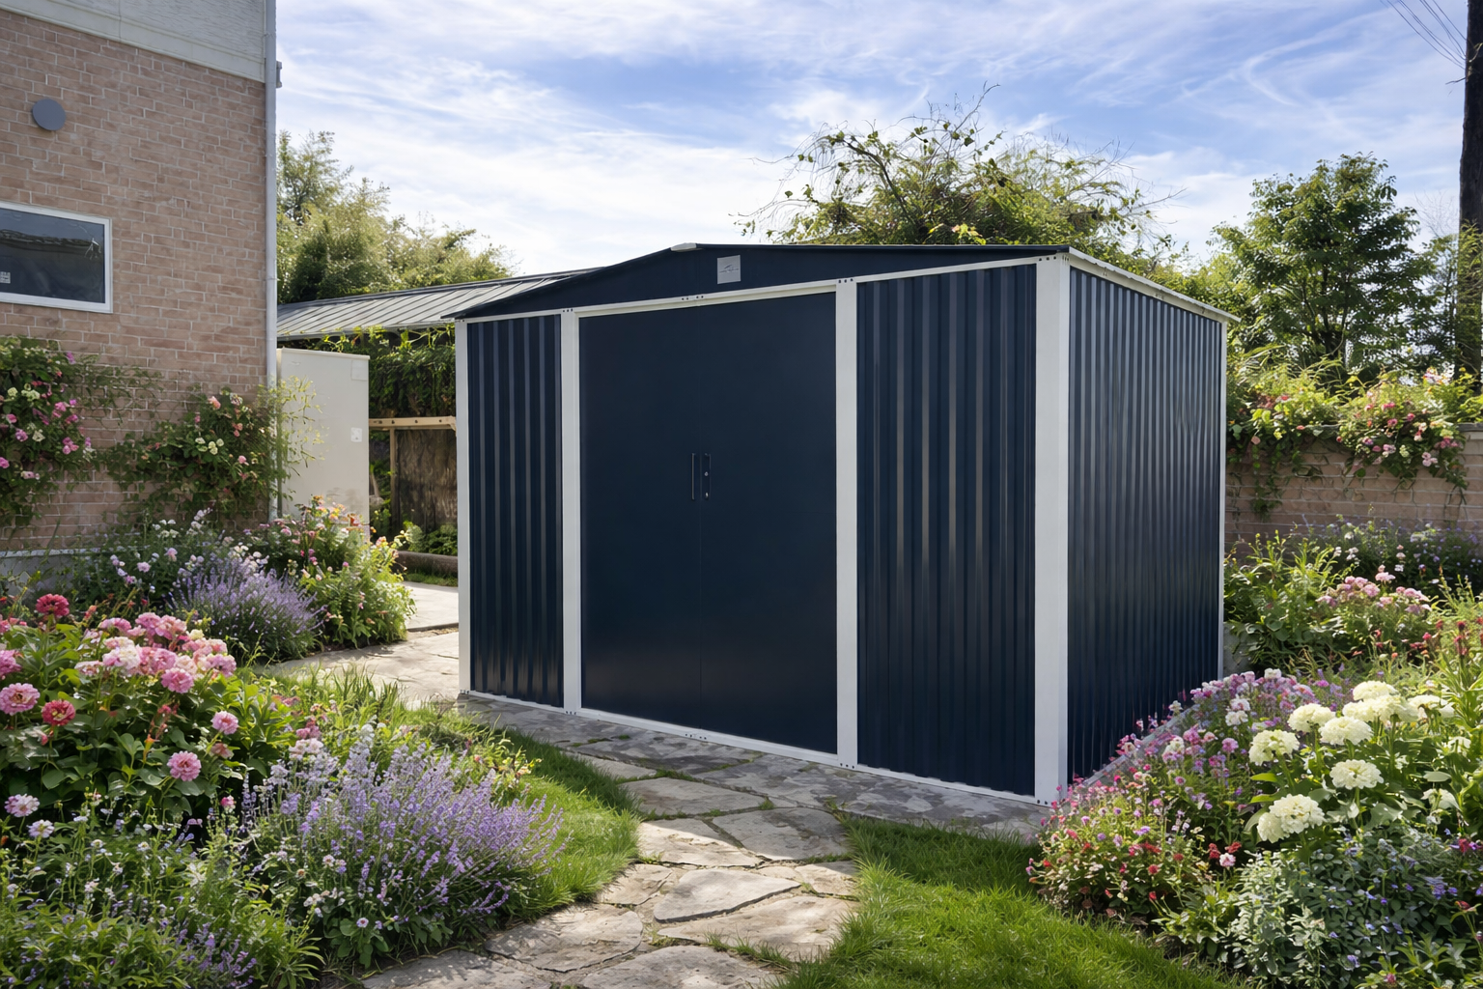
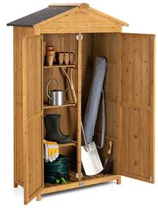

Home & Garden New Products
Hot & Cool Fan Heater
Cooling
Panel Heaters
Internal Seating
Metal Planters/Screens
Outdoor Living
Parasol & Awnings
Garden Decor
Metal & Wooden Storage

Slide 19





Electric Life Shop & Website
2026 saw the addition of global brands Trek, Brompton and Amflow to complement the existing portfolio of Orbea, VanMoof, Whyte, Tern alongside own-brands Claud Butler, Dawes and Falcon
Website growth; Sessions +14%, Users +19% and transactions +40%
Range extensions in mechanical and electric ranges via supplier integrations
Accessible showroom location with trained experts offering test ride options
Mechanics trained in market leading ebike systems
Cycle to work schemes and finance options online and instore

Slide 20

Warehouse Operations
Completely self-sufficient, 160,000 sqft premises owned by the group
Perfectly located adjacent to our existing premises
Commercial and strategic benefit
Third Party Storage
Cost saving efficiencies being realised

Slide 21

Summary
Strong Balance Sheet
Talented Colleagues
Exploring Acquisitions
Growing Customer Base
Increasing Market Share
European Expansion
Driving Operational Efficiencies
Freight Cost Fluctuations
New Product Innovation
Middle East & Tariff Uncertainty
Rising Employment Costs
Hong Kong Sourcing Office

Slide 22
Q&A

Slide 23
Disclaimer
This document does not constitute or form part of any offer or invitation to sell or issue, or any solicitation of any offer to purchase or subscribe for, any shares in the Company, nor shall any part of it nor the fact of its distribution form part of or be relied on in connection with any contract or investment decision relating thereto, nor does it constitute a recommendation regarding the securities of the Company. This document has not been verified, does not purport to contain all information that a prospective investor may require and is subject to updating, revision and amending. The information and opinions contained in this document are provided as at the date of this presentation and are subject to change without notice. In furnishing this document, the Company does not undertake or agree to any obligation to provide readers with access to any additional information or to update this document or to correct any inaccuracies in, or omissions from, this document that may become apparent. Recipients of this presentation should each make their own independent evaluation of the Company and should make such other investigations as they deem necessary. No reliance may be placed for any purposes whatsoever on the information or opinions contained in this document or on its completeness.
No representation or warranty, express or implied, is given by or on behalf of the Company its directors, officers or employees or any other person as to the accuracy or completeness of the information or opinions contained in this document and no liability whatsoever is accepted by the Company or any of its members, directors, officers or employees nor any other person for any loss howsoever arising, directly or indirectly, from any use of such information or opinions or otherwise arising in connection therewith. This document contains forward-looking statements concerning the financial condition, results of operations and businesses of Tandem Group plc (“the Company”). All statements other than statements of historical fact are, or may be deemed to be, forward-looking statements.
Forward-looking statements are statements of future expectations that are based on management’s current expectations and assumptions and involve known and unknown risks and uncertainties that could cause actual results, performance or events to differ materially from those expressed or implied in these statements. All forward-looking statements contained in this presentation are expressly qualified in their entirety by the cautionary statements contained or referred to in this section. Readers should not place undue reliance on forward-looking statements. Each forward-looking statement speaks only as of the date of this presentation. Neither the Company nor any of its subsidiaries undertake any obligation to publicly update or revise any forward-looking statement as a result of new information, future events or other information. In light of these risks, results could differ materially from those stated, implied or inferred from the forward-looking statements contained in this presentation.

