Slide 1


Annual General Meeting
17th June 2026

Slide 2

AGENDA
Product Showcase Video
Retail & Market Landscape
Economic Landscape
Product / Brand Development
Summary

Slide 3
Showcase Video

Slide 4
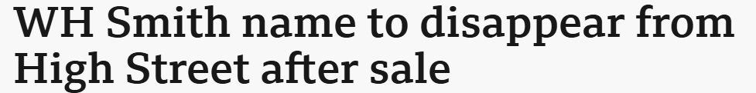
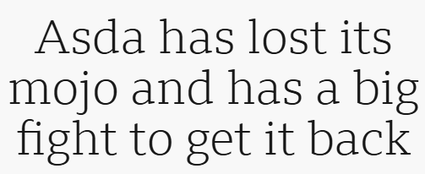
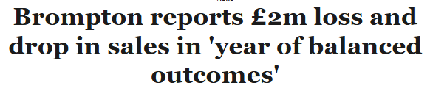



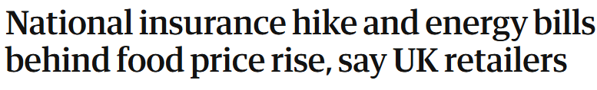
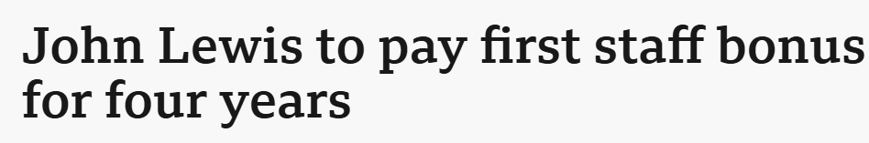
Retail & Market Landscape
Mike Ashley’s Frasers Group swoops to buy Frog Bikes, as embattled children’s bike brand joins growing Sports Direct and Evans Cycles empire
Kingfisher keeps profit outlook despite soft market hitting B&Q sales
Energy price cap will rise by 13% from July
UK supply chain can't escape
uncertainty following the Iran war
Improving consumer confidence held back by price fears
Morrisons Daily to continue franchise expansion despite shutting 100 company-owned stores
UK cycling distributor Saddleback to enter administration with all staff facing redundancy
China’s JD.com mulls $2.7bn bid for The Very Group

Slide 5
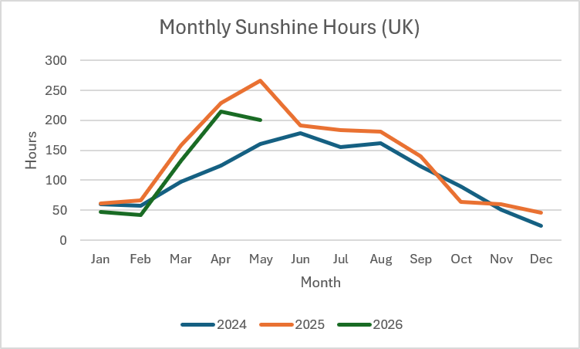
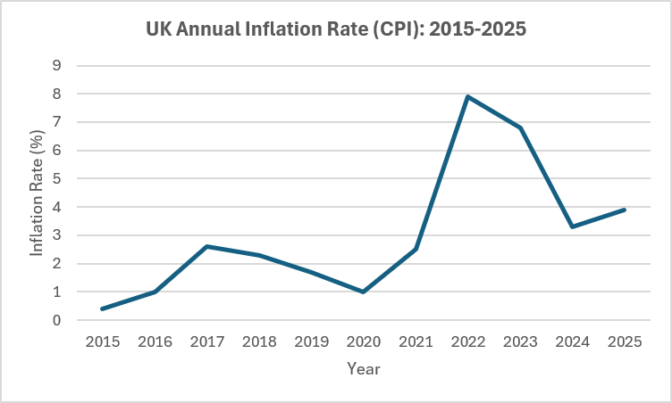
Economic Outlook
Bank of England Base Rate remains at 3.75%, but was expected to reduce
Inflation at 2.8% April, remaining above the 2% target
Consumer spending resilient but increasingly value-focused
UK energy cap increase by 13% on1st July, impacting disposable income
  Global tariff and trade uncertainty
  Energy prices remain vulnerable to geopolitical developments, increasing cost of plastics and factory running costs
  Freight and supply-chain costs increasing
  Inventory levels largely normalised across retail sectors
  GBP vs USD strengthening

Slide 6








Toys, Sports & Leisure
Secured landmark pan European, UK, Eire and Middle East partnership with Netflix for K-Pop Demon Hunters, representing a major expansion of M.V’s international licensing strategy
Expanded European licensing portfolio with Aston Martin Aramco Formula One Team, SEGA Sonic and Steal a Brainrot on Roblox
Successfully launched new car and travel accessories category, opening opportunities with new customers and retail channels
Added 12 new customer accounts across UK and international markets during the last 12 months
Strong performance from key licensed brands including Disney, Marvel, Bluey, Hot Wheels and Sonic
Over 200 new and refreshed products launched across wheeled, outdoor and preschool categories during the last 12 months
Continued growth across FOB and European distribution channels, supported by dedicated international resource
Positive early AW26 retailer engagement and exclusive programme discussions across UK and European customers

Slide 7
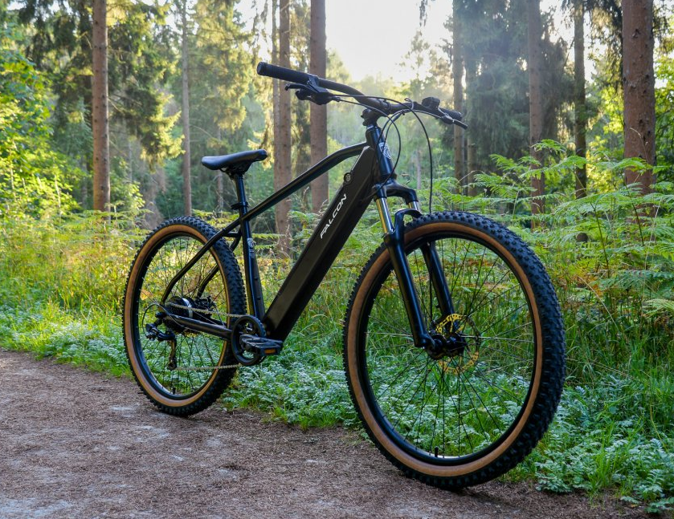
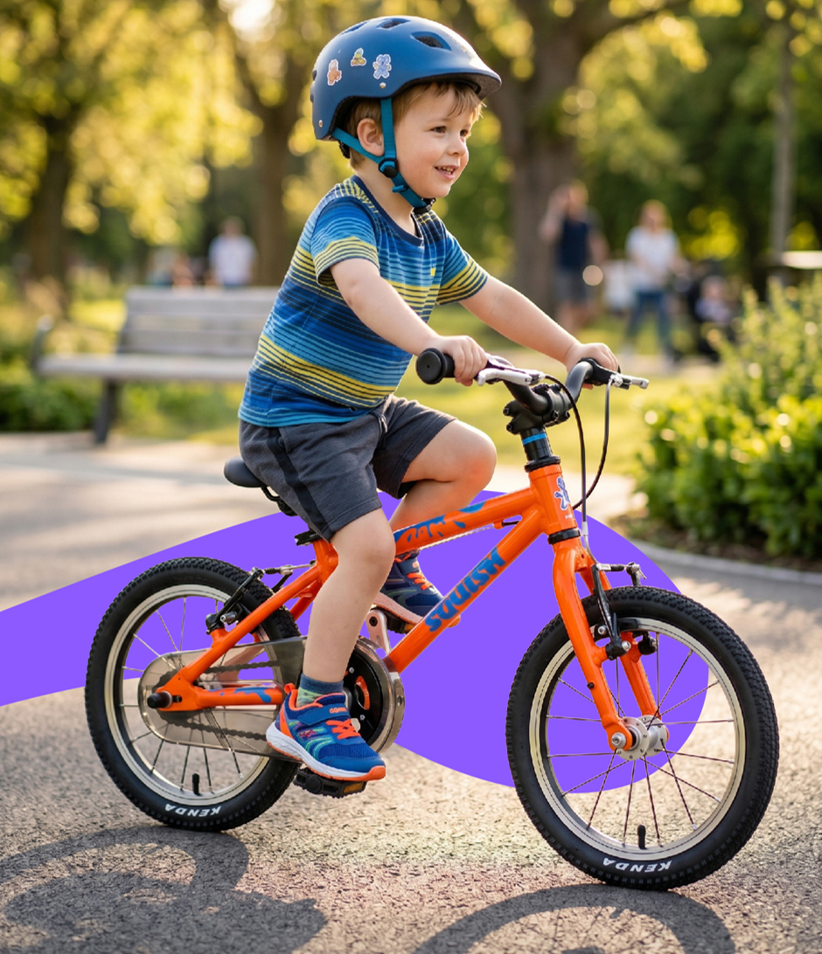
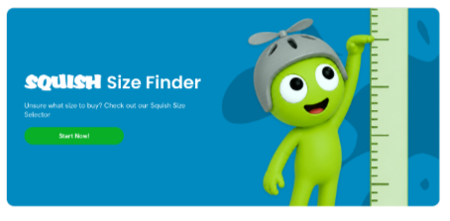
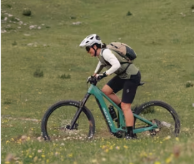
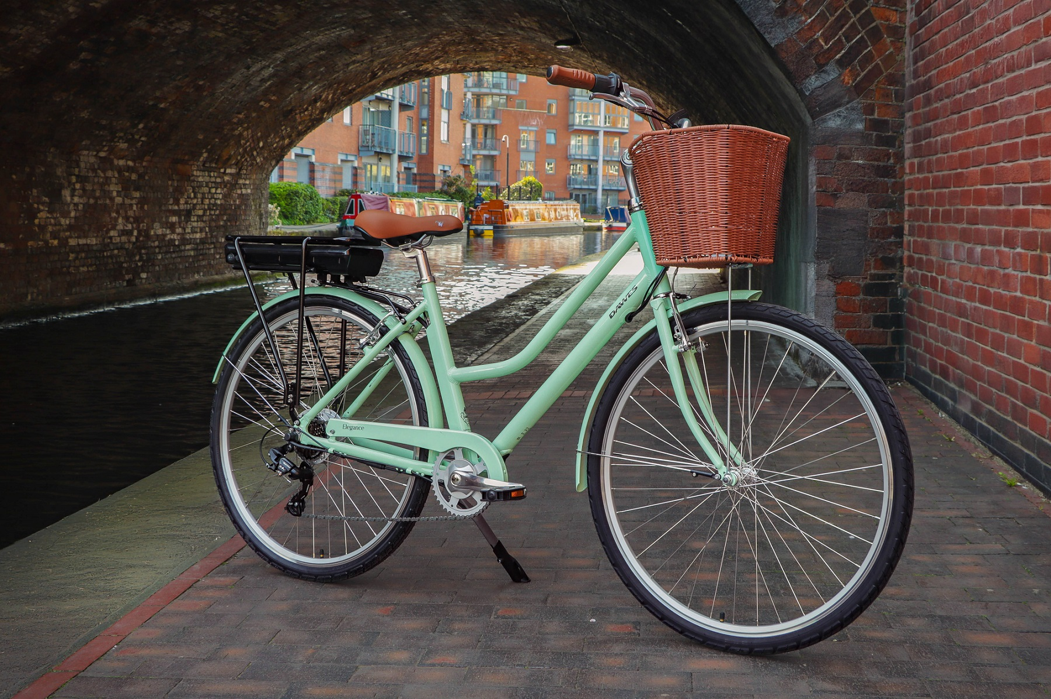
Bikes
Cementing our position as the leading distributor in affordable eBikes and mechanical bikes to national retailers and independent bike dealers
Bringing a comprehensive range of eBikes to market covering all styles/disciplines from £999.99. Including 6 x models in the key sub-£1100 category and refreshed eMTBs
Capitalise on the opportunities in the premium lightweight kids’ bikes segment following the administration of Frog Bikes, onboarding an additional 15 UK dealers to date
Introduce a new standalone Squish website, in the second half of the year, with dealer finder, sizing tool and Click & Collect functionality
Launching a new range of entry price point adult/junior mechanical bikes and a refreshed range of BMX bikes in Q4
Expanding our European presence by introducing our bike portfolio through varied distribution channels, led by our new Head of International Sales
Electric Life will expand its retail proposition in Summer 2026 with the addition of globally recognised brand, Scott

Slide 8
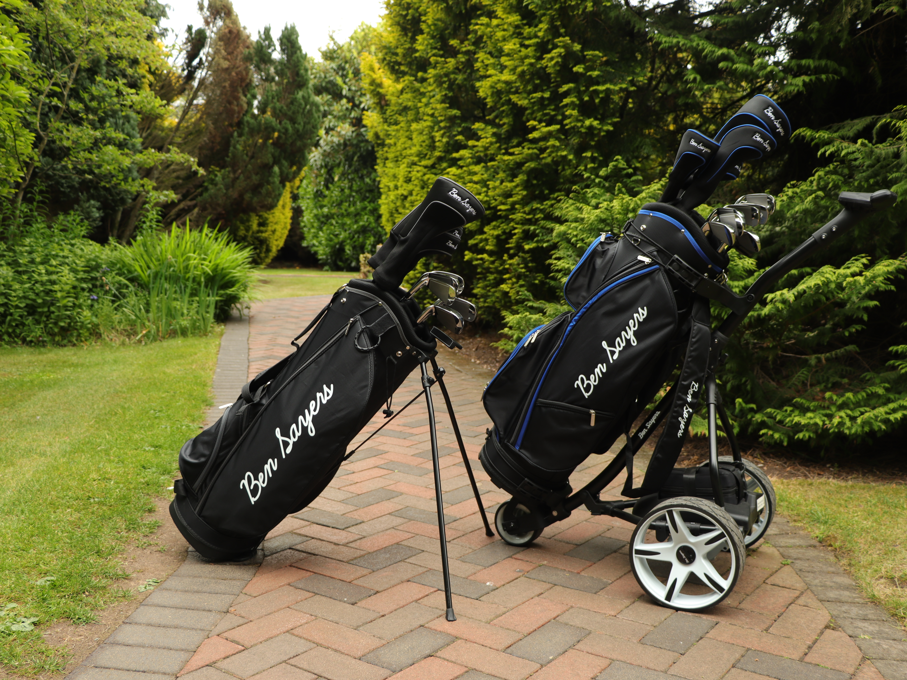
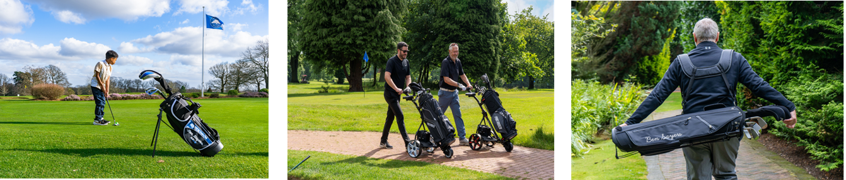
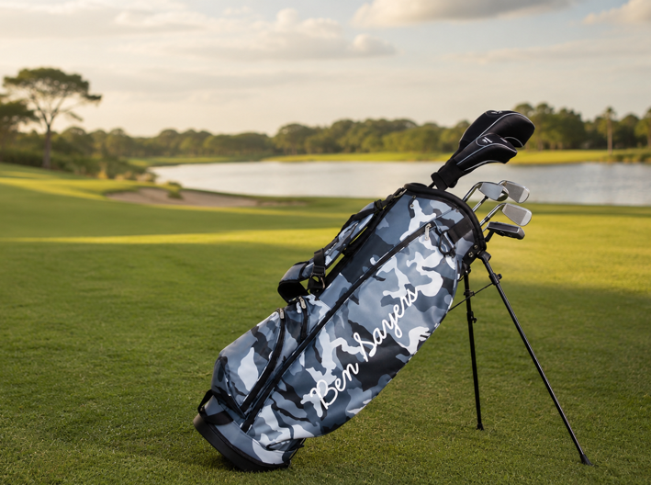
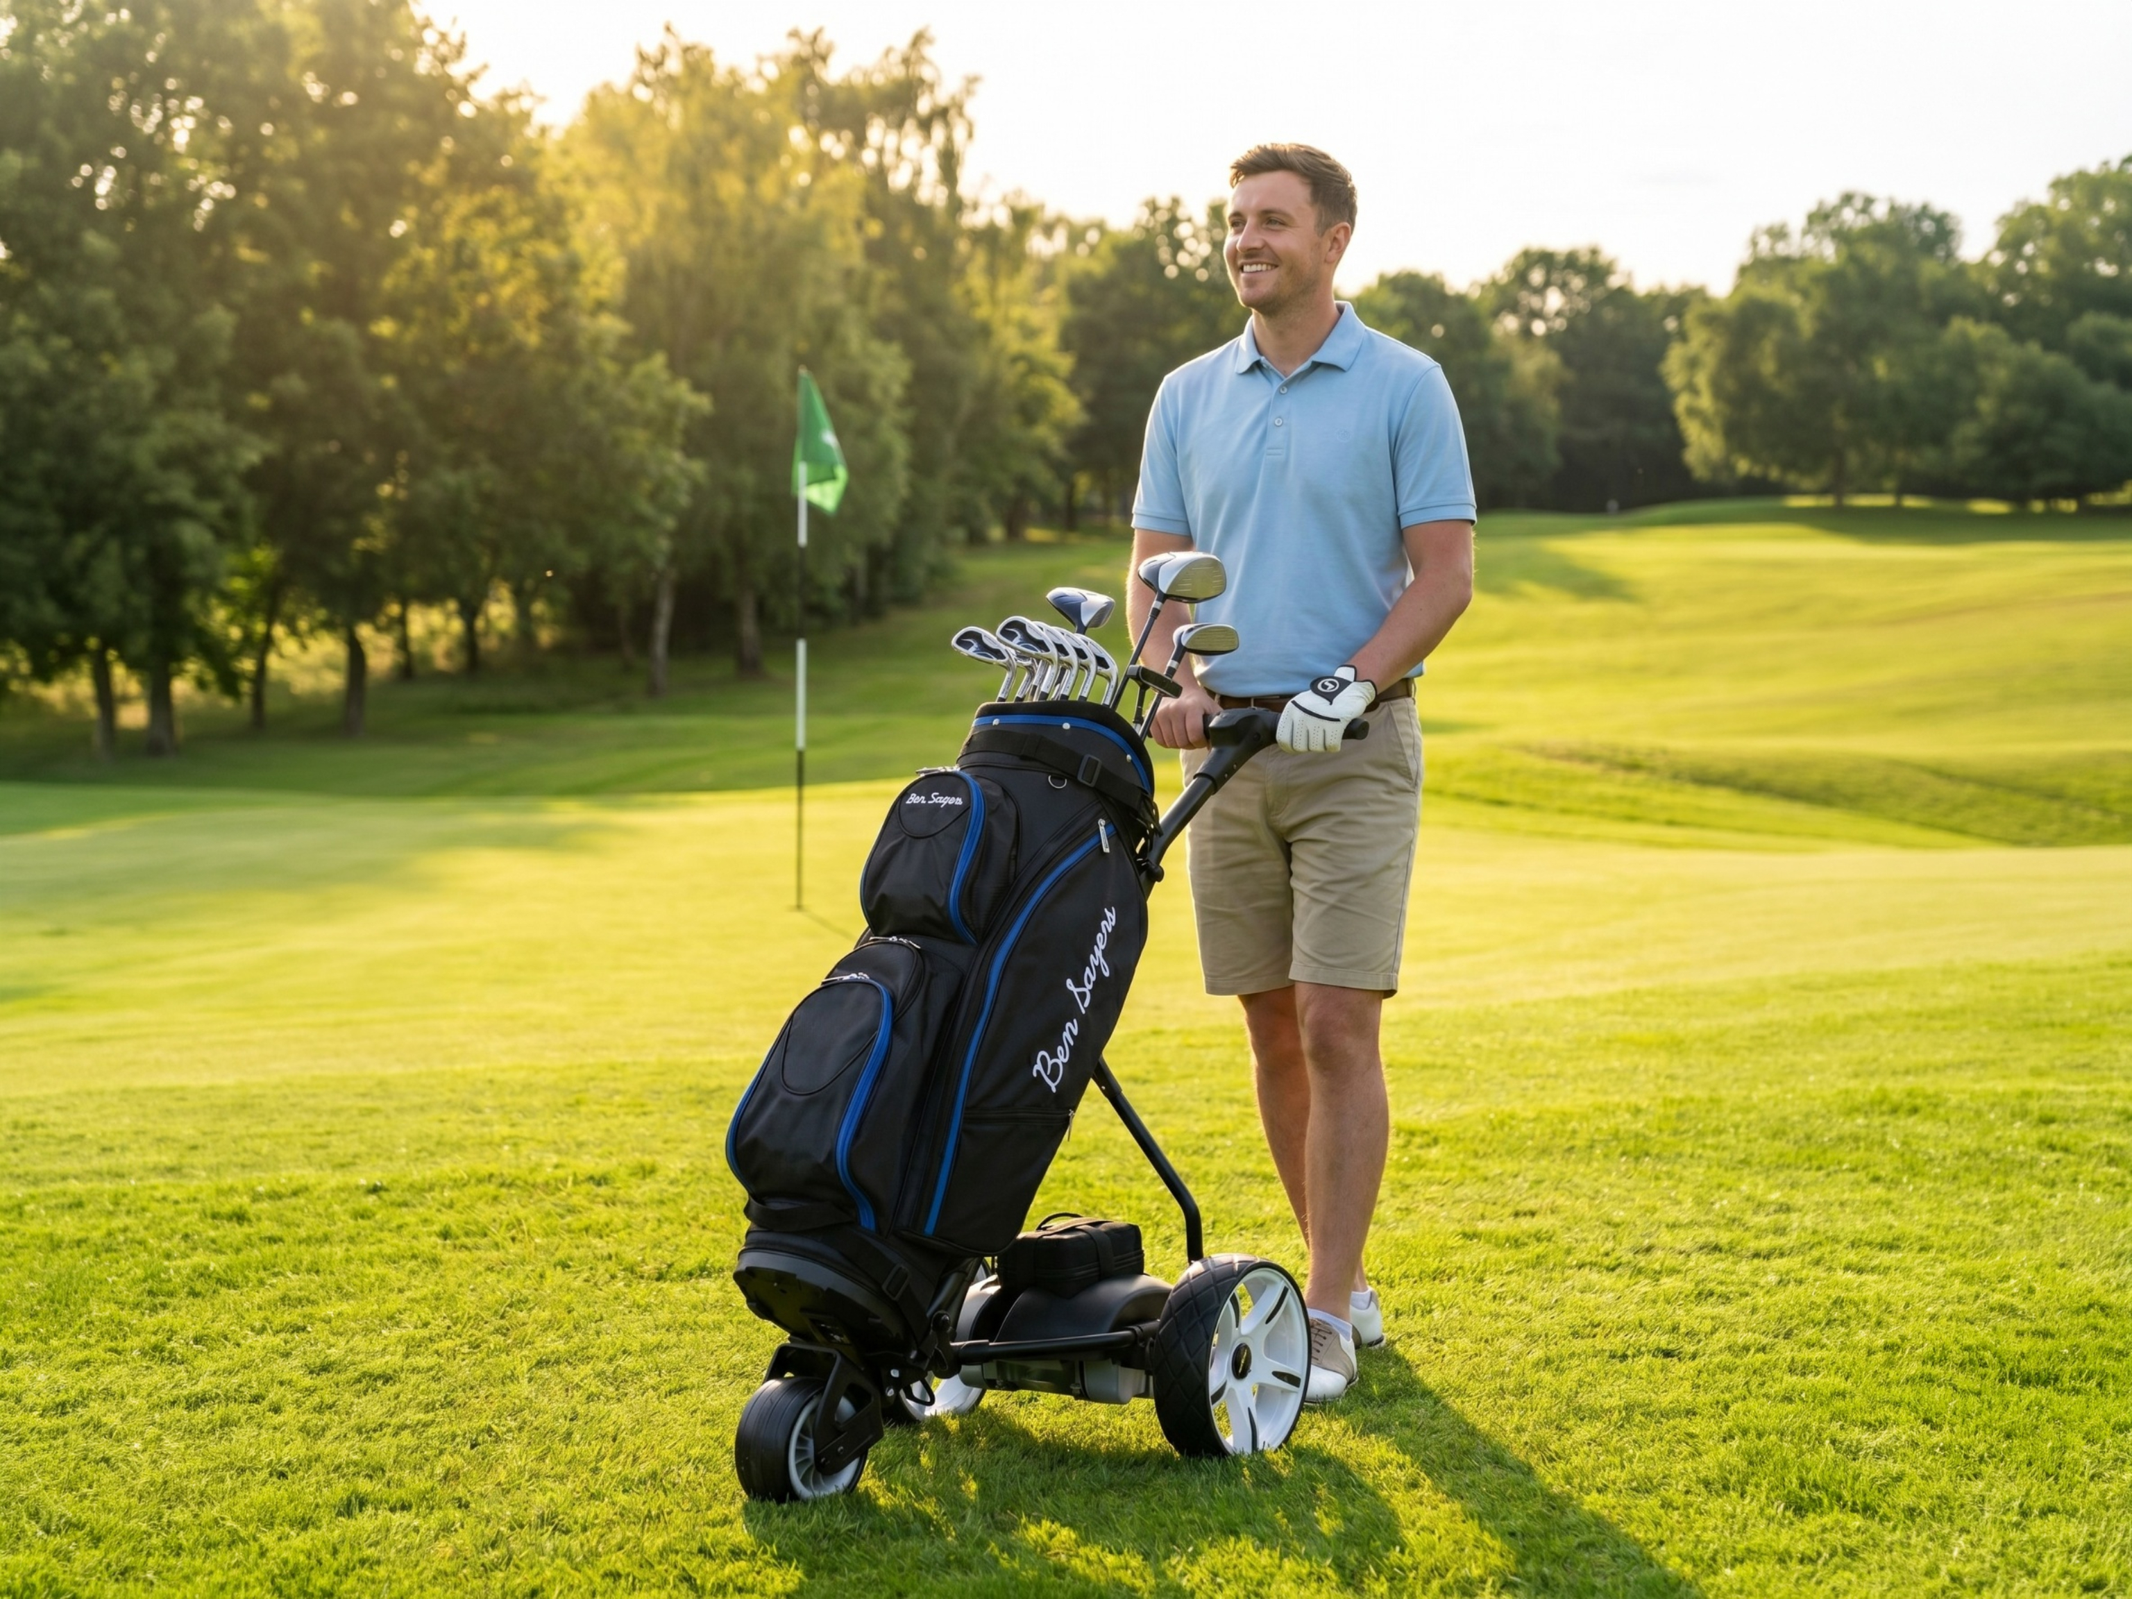
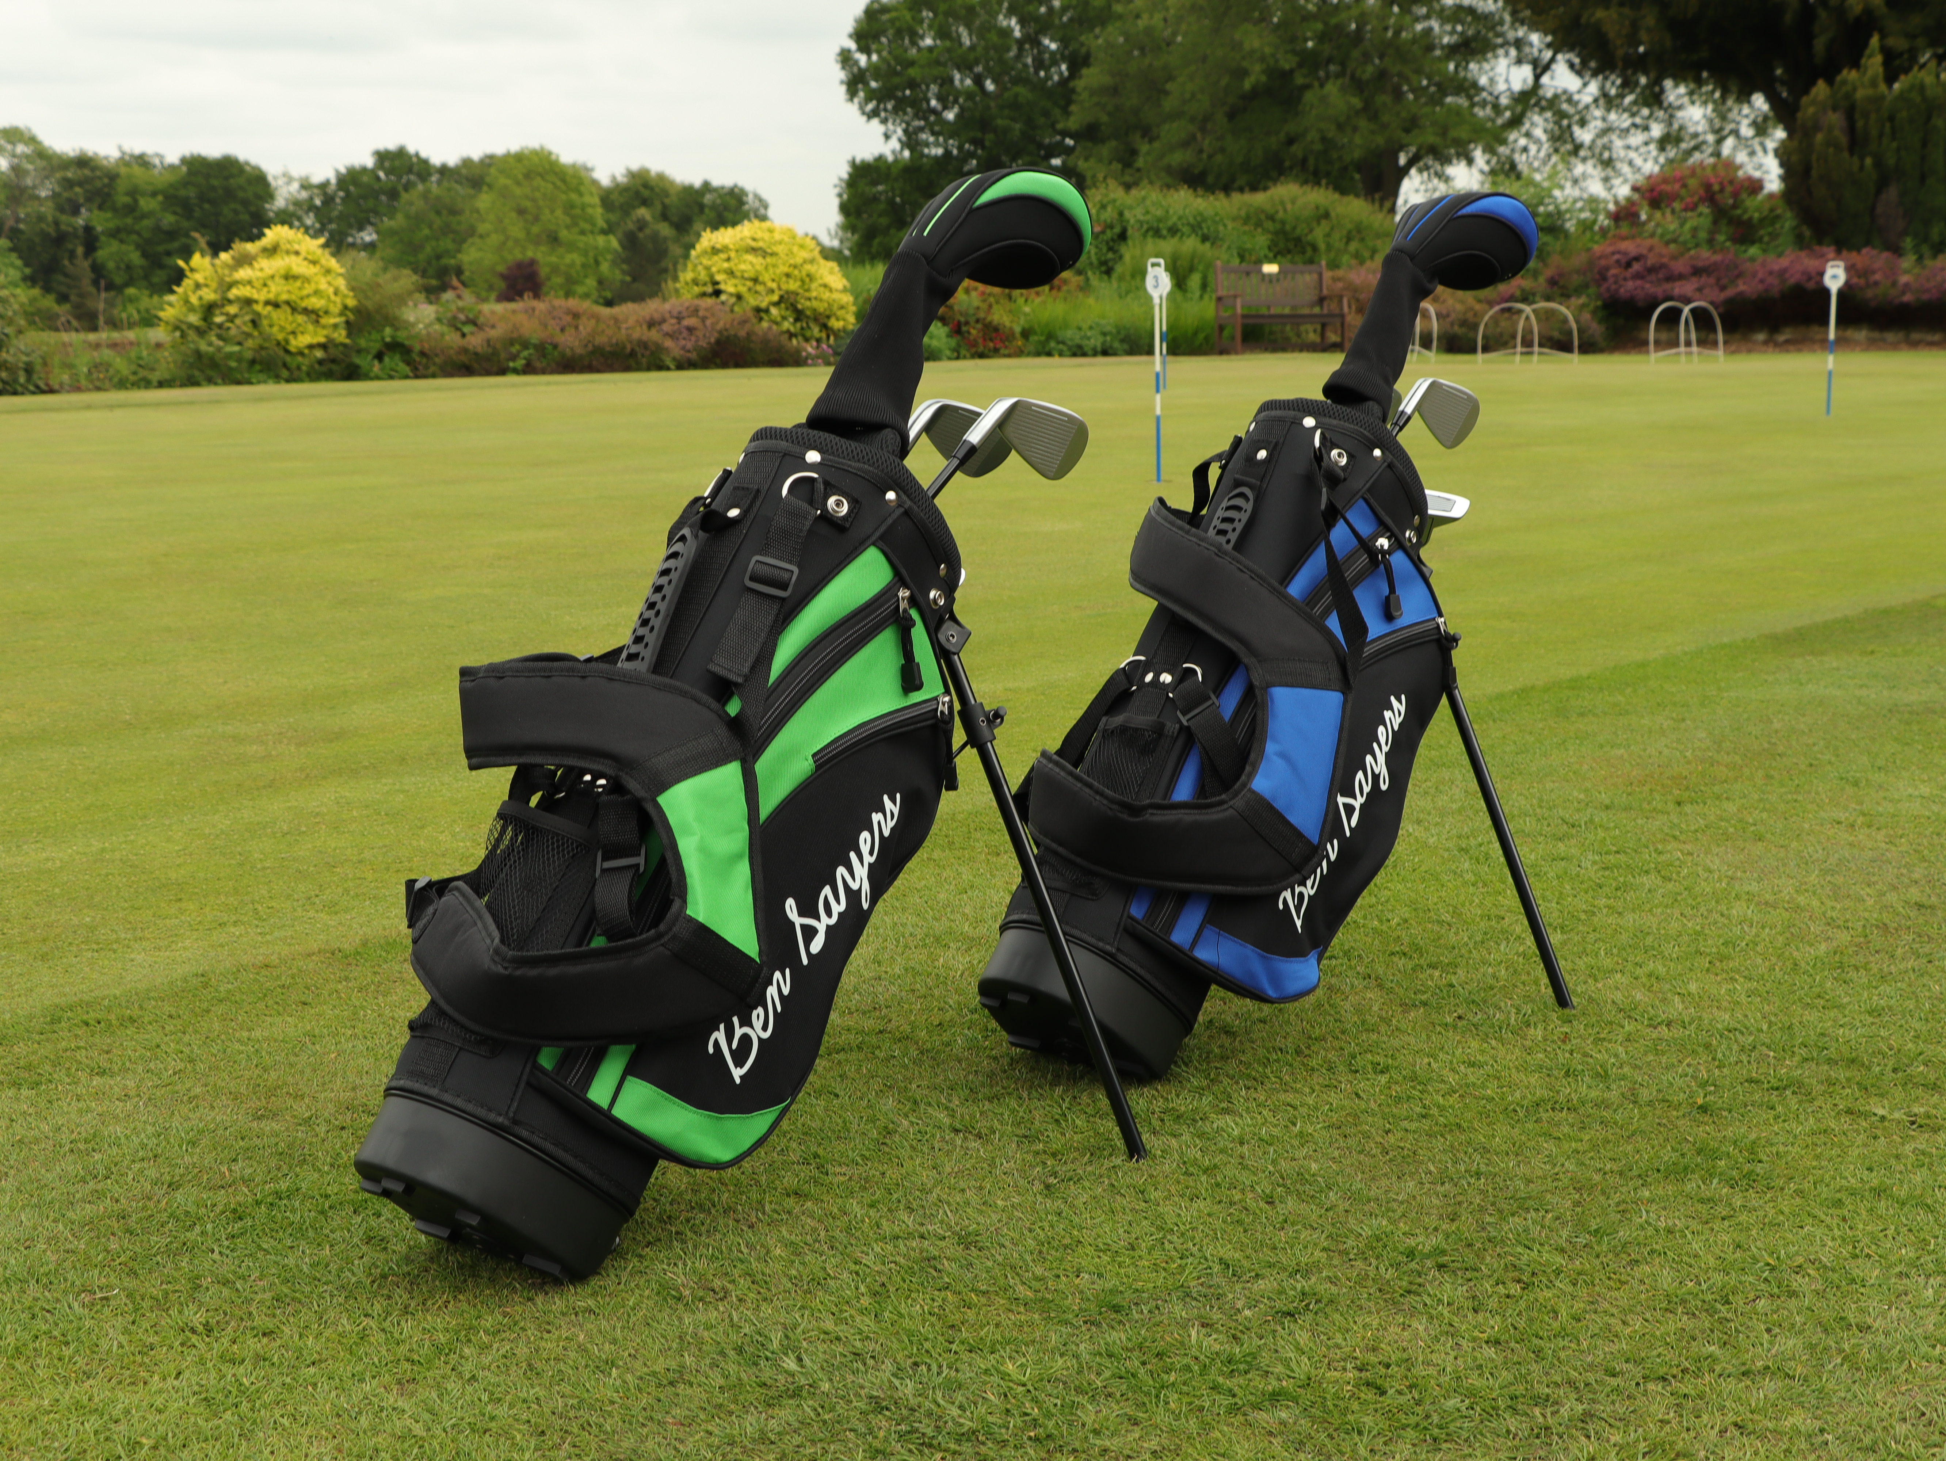
Golf
Ben Sayers
Embed our new range of value-for-money package sets in key national and specialist retailers to grow market share
Transition more key accounts to direct container purchasing with a focus on exclusive product options/colour ways
Expand domestic range representation with new on-course and off-course retailers
Accelerating international growth with European golf distributors & retailers
Ongoing development of the next generation of electric trolleys
Pro Rider
Cementing ourselves as the best value-for-money electric golf trolley brand in the market.
Trade reactively across own-brand websites and marketplaces due to our focus on stable year-round product availability
Introducing electric trolleys and junior package sets into additional national retailers

Slide 9
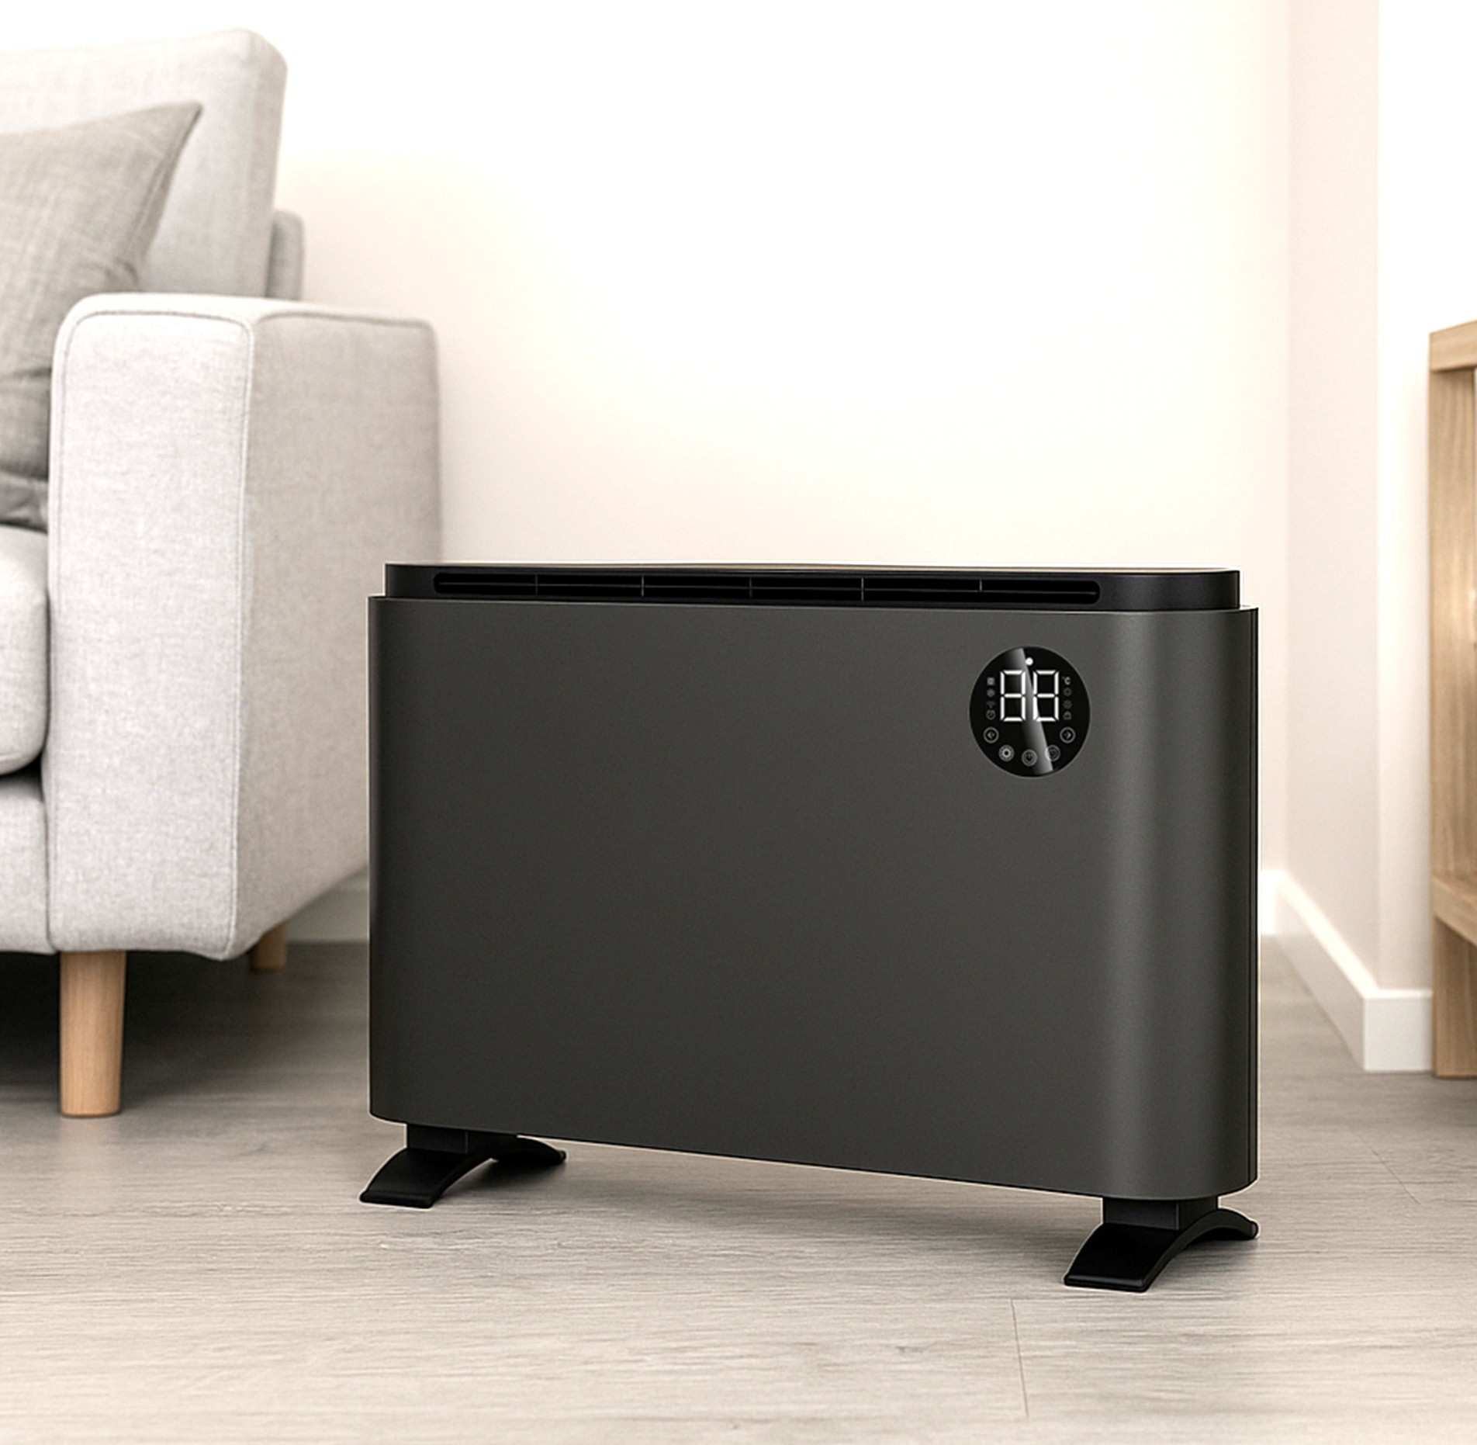
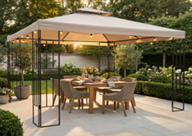
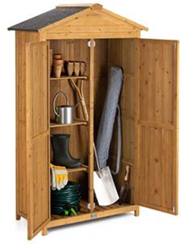
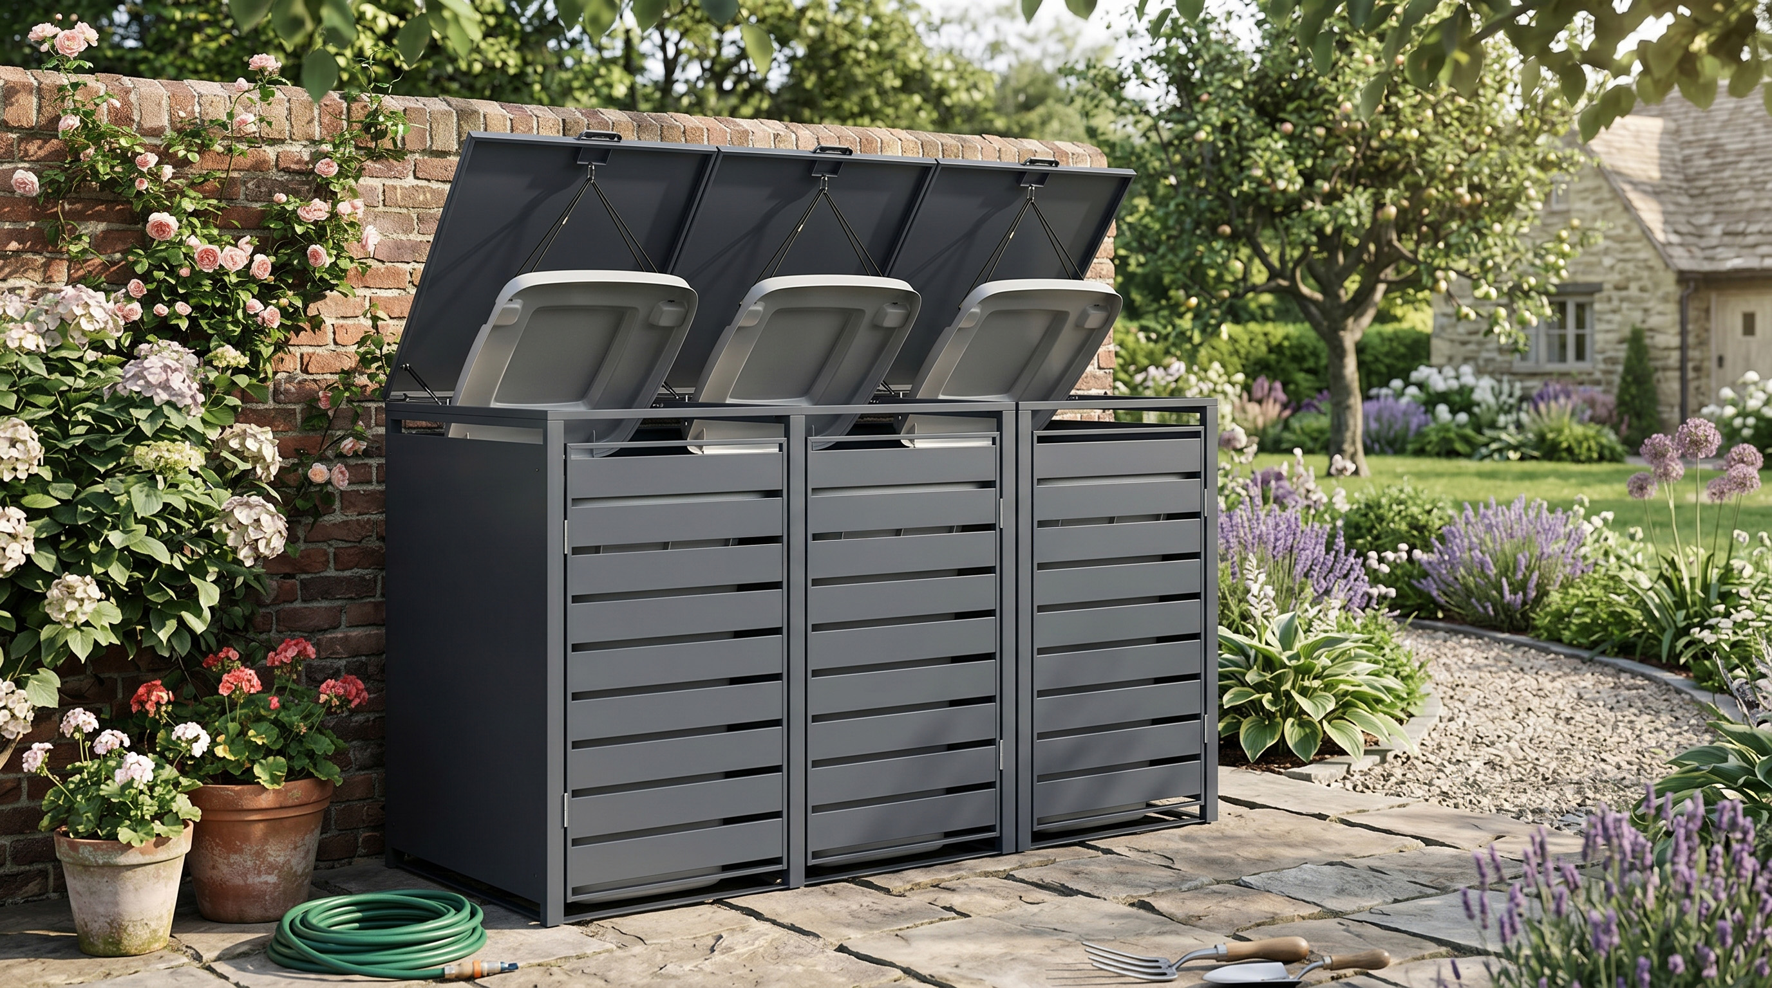
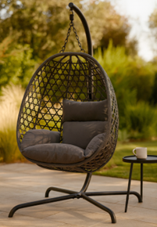
Home & Garden
Expanding core categories: cooling, outdoor living, parasols, awnings and outdoor heating
New launches in Q2/Q3 across indoor heating, metal & wooden storage
Improved L4L stock availability, with strengthen EU & UK supplier base to support new product trials and speed to market
New direct dispatch partnership with UK supplier, reducing stock holding costs
Flexible ordering and mixed container strategy improving stock efficiency and costs
Increasing average order value and basket size through enhanced range selection
Growing marketplace expansion to reach new customers
Improving ROI and conversion through enhanced content, optimised product listings and AI

Slide 10

Summary
Strong Balance Sheet
Talented Colleagues
Exploring Acquisitions
Growing Customer Base
Increasing Market Share
European Expansion
Driving Operational Efficiencies
Freight Cost Fluctuations
New Product Innovation
Middle East & Tariff Uncertainty
Margin Improvement​
Hong Kong Sourcing Office

Slide 11
Annual General Meeting
17th June 2026

